Slide 1
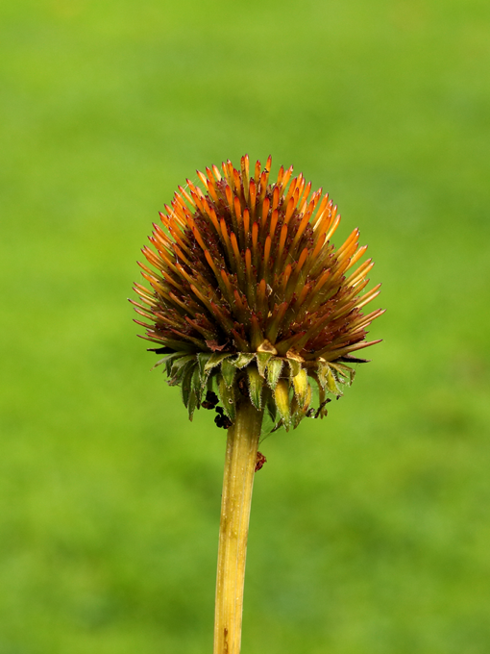
Reveal Nature through Interpretation
Amber Myers, CIG

Slide 2
Today I will…

Slide 3
YOUR Purpose
Notes:
Why are YOU there as the guide? What is your Purpose in communicating with your audience?
What do you want them to know before they leave?

Slide 4
Interpretation is…
“…a communication process that forges emotional and intellectual connections between the interests of the audience and the inherent meanings in the resource.”
–National Association for Interpretation
Notes:
To form these connections, through any method of communication, you need to know who your audience is, and you need to be familiar with your resource.

Slide 5
Types of Interpretation
Formal: Fully developed, researched, and prepared.
Informal: Unscheduled interactions.
Notes:
These are PERSONAL SERVICE interpretation
Formal example: Bison classroom program for fourth grade class
Informal example: Talking to a family who are exploring the trails on a walk together

Slide 6
Types of Interpretation
Living History: Recreation of a person, place, or event
Signage: Interpretive text on signs and labels
Notes:
Signage is an example of STATIC INTERPRETATION
Living history example: Dressing up like an early pioneer and discussing life on
the prairie
Signage example: Signs, trail brochures, QR codes that take you to a video or sound bytes, does not require a person on site to direct the experience.

Slide 7
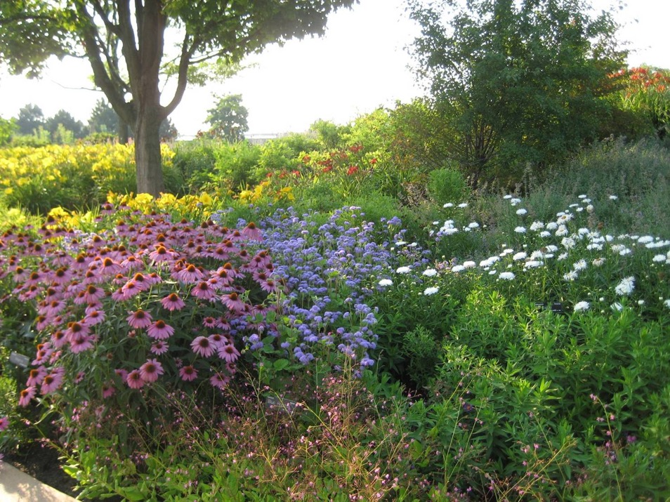
Principles of Interpretation
&
The Gifts
Freeman Tilden
Larry Beck and Ted Cable
Notes:
Let’s look at the philosophies of interpretation, these will help you plan and perform in the most effective way.
Beck and Cable Handout
Tilden: Known as the “Father of Interpretation”
Wrote “Interpreting Our Heritage” where he discussed 6 principles of interpretation
We will talk about each of his 6 principles
In this presentation some of the principles are written in Tilden’s words and some are written in Beck and Cable’s words but they are still Tilden’s 6 original principles
Beck & Cable: Ted Cable is a professor at Kansas State University
Dr Cable wrote a book that updated and expanded Tilden’s 6 principles to 15 principles, which he calls “gifts”.
Handout of the 15 principles is in the appendix of the interp manual.
The first 6 are the same as Tilden’s 6, just worded differently. We will talk about those 6, and a couple of Cable and Beck’s. In this training, sometimes I use Tilden’s wording and sometimes I use Beck & Cable’s wording, but they are essentially the same.

Slide 8
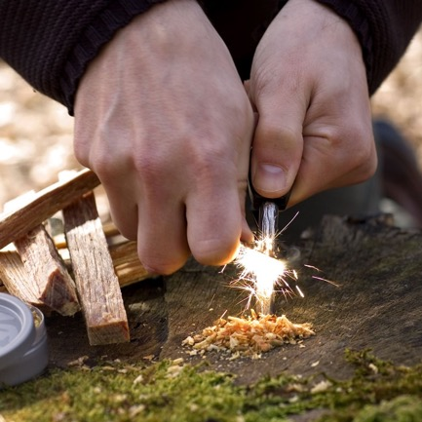
The Gift of a Spark
Any interpretation that does not somehow relate what is being displayed or described to something within the personality or experience of the visitor will be sterile.
Notes:
To spark an interest, interpreters must relate the subject to the lives of the people in their audience.
To relate to the audience, you must first KNOW YOUR AUDIENCE
People need to feel like the subject affects them. They are more likely to find it important and motivational. If it does not, they are very likely to lose interest.

Slide 9
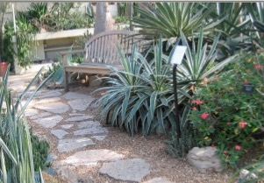
Know Your Audience
Rechargers
seek restorative
experiences and see the site as a refuge or escape
Notes:
John Falk’s Visitor Identity Related Motivations – John Falk is a leader in museum studies and co-founder of the research firm “Institute for Learning Innovation”
important to KNOW YOUR AUDIENCE
Who are you talking to? Why are they there?

Slide 10
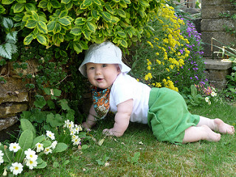
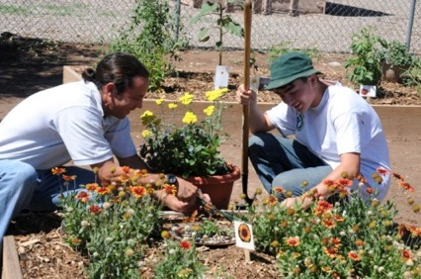
Explorers
curiosity driven with a generic interest in the content and expect to learn or find something new
Facilitators
socially motivated and want to enable the learning/experience of others

Slide 11
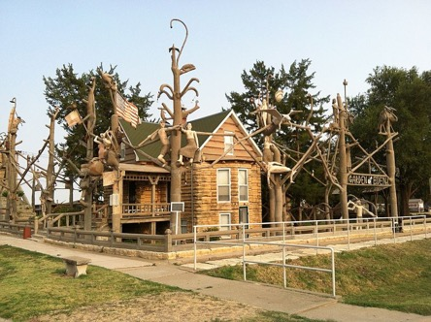
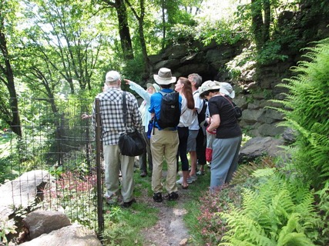
Experience Seekers
perceive the site as an important destination and as a prestigious attraction in the area
Professional Hobbyists
content specialists and visit to discover new ideas or find answers to questions

Slide 12
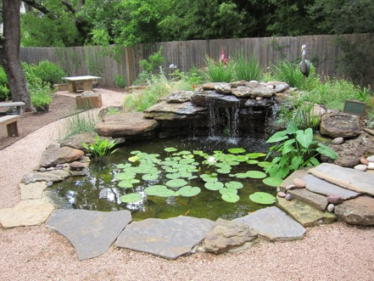
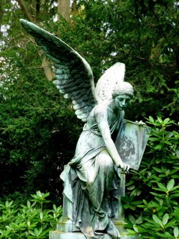
Affinity Seekers
Motivated to visit a particular location because it speaks to their sense of heritage and big “I” Identity or personhood
Respectful Pilgrims
Visit out of sense of duty or obligation to honor the memory of those represented by the institution/memorial

Slide 13
People often choose leisure activities that support and meet the needs of their motivational related identities.
Motivational related identities are flexible, and one guest may fall into multiple categories during one visit or switch identities each time they visit.

Slide 14
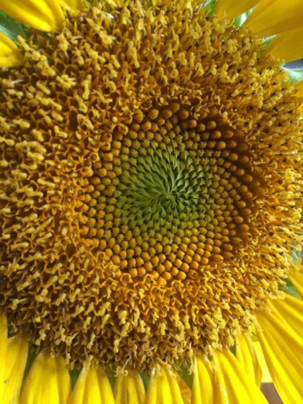
The Gift of Revelation
Information, as such, is not interpretation. Interpretation is revelation based upon information. But they are entirely different things. However, all interpretation includes information.
Notes:
“This is a sunflower” vs. “this is not only one flower, but many. Take a closer look.” We help people SEE for themselves.
Not just spitting out information, but helping people go deeper and connect. You are not the “sage on the stage”, you are there to facilitate experiences and discovery.
You may know everything there is to know about your site, but your audience members do not wish to be experts when they leave. They are there for different reasons.
It is important that you are knowledgeable about your resource.
Make sure the information you do give is correct! It is better to admit that you don’t know an answer than to make one up and give false information. Also, people will respect you more and believe the information you do give more if they know you only give information you know is correct. If you don’t know, say so, then direct the visitor to a resource that might have the answer, whether it is a person, book or website. When possible, help the visitor to find the answer.
Inaccurate information spreading like wildfire can last beyond lifetimes. For example, We’ve all heard that once a baby bird is handled by its mother she won’t care for it anymore.

Slide 15
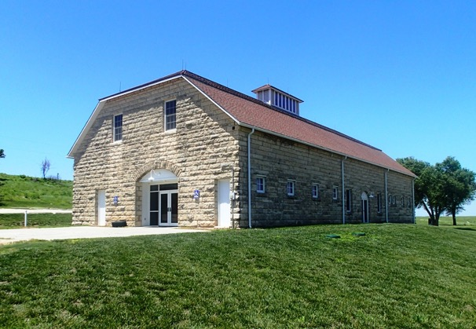
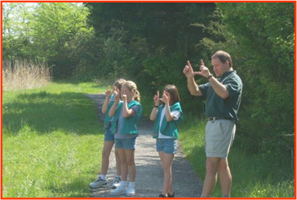
Helping your audience see
Tangibles
Notes:
Tangibles are the things that people can see, hear, touch, smell. It exists in reality for everyone. An example for a tangible in your program might be an old barn that you come across on your walk through the prairie. Everyone can experience the barn, You can go into the barn and find the structure of it. It may be updated to be more modern with amenities like running water and electricity.
If you are spouting the facts of the barn “It was built in 1911 by Walter Burr, it is XX sq feet and it was used for storage of livestock feed and horses” those are facts that are nice to share, but they don’t give the audience the feel of the importance on a deeper level. Being too “bookish” means the audience loses out and you have probably bored them. That’s where “intangibles” can reveal the deeper meaning of the barn. People won’t remember all those facts. They will remember how they felt.

Slide 16
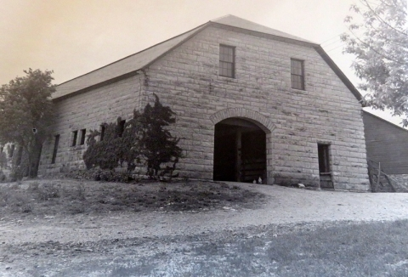
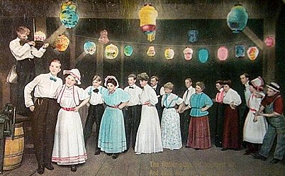
Helping your audience see
Intangibles
Notes:
Let’s make that barn mean something…
Tell the story of the barn. Use words that connect the real life experiences of your audience to the barn. Words like “safe, home, life, success, failure, starvation, fullness, death, sorrow, family” are all things that every person can connect to on an emotional level. These are called Universal Concepts.
The fact is, that barn is not just a building. There were dances held here, where people of the area found love and celebrated together. It was built by a local stonemason with limestone taken from just a few miles away. It was built to keep draft horses safe from the elements, so that they were healthy and strong to work on the ranch. The feed that was stored here was someone’s hard work and livelihood and would have caused certain financial doom if they lost the horses and their supplies. Those financial losses would have meant possibly losing their home and having to leave the area. It took blood, sweat and tears to create and preserve that barn. That barn served the family who lived on the ranch and the many ranch hands who worked to take care of the land and the cattle. This barn protected their most valuable investments and provided a place for family and friendships to develop.
Be descriptive and help your audience see that it is more than a building.

Slide 17
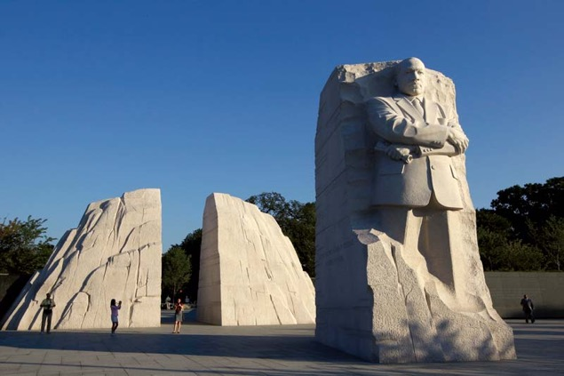
The Gift of Story
Interpretation is an art, which combines many arts, whether the materials are scientific, historical, or architectural. Any art is in some degree teachable.
Notes:
The interpretive presentation, as a work of art, should be designed as a story that informs, entertains and enlightens.
Freeman Tilden said “The artist ruthlessly cuts away all the material that is not vital to his story”
DC Martin Luther King, Jr Memorial
“Out of the mountain of despair, a stone of hope,” a line from Dr. King’s “I Have a Dream” speech, is cut into the stone.

Slide 18
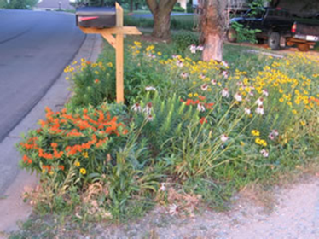
The Gift of Provocation
The chief aim of Interpretation is not instruction, but provocation.
Notes:
Want to provoke people to do something, whether it is an actual behavior, such as recycling or donating money, or changing attitudes about “wildflowers” a.k.a. “weeds” or simply thinking more about the subject and wanting to learn more
When your audience leaves, what is it you want them to take with them? What do you want them to do? Make sure your presentation leads to this desired outcome.

Slide 19
The Gift of Wholeness
Interpretation should aim to present a whole, rather than a part, and must address itself to the whole person, rather than any phase.
Notes:
Interpretation should present a complete theme (whole) and address the whole person.
For now, let’s focus on “WHOLE” person:
This is where you’re the visitor’s reason for being there comes in to play. This is why you need to know your audience and their motivational identities. Remember those? (explorers, facilitators, pilgrims, etc.) Make sure you are addresses those motivational identities.
Presenting the WHOLE of your site is not what is meant here. That would likely be impossible. Remember, it’s OK to cut away the parts of the story that are not essential to your message. We will talk more about themes in a bit.
Present one basic theme or idea
Themes
Why Use Themes?
Ham concluded that if people are not given a theme, people won’t comprehend or recall any better than if they are given a bunch of unrelated sentences jumbled together (Beck and Cable pg 49)

Slide 20
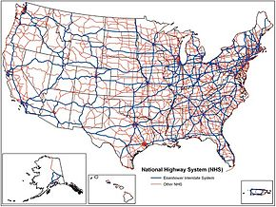
Notes:
Give me directions from Kansas City to Salina using highway numbers.

Slide 21
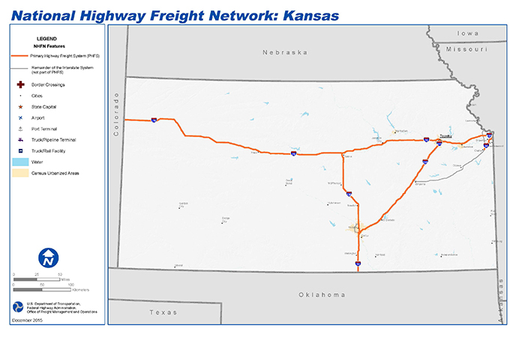
Notes:
Much easier when you narrow down the amount of data to sort through! We cut away to the main focus: our destination.
After finishing up the last of the 6 principles I’m covering today, we will take a break. After the break, we will take a closer look at themes and putting all of this into practice!

Slide 22
The Gift of Targeted Programs
Interpretation addressed to children, (say, up to the age of 12) should not be a dilution of the presentation to adults but should follow a fundamentally different approach To be at its best it will require a separate program.
Notes:
You can’t interpret to someone who is 30 the same as someone who is 6, or 14. Each age group must be approached differently. When talking to a group with mixed ages, talk at about a 6th grade level.
That doesn’t mean, when you are talking to a family, that you shouldn’t crouch down and talk to the 3 year old. Actually, that is encouraged!!!
If you know your audience is going to be senior citizens, what might some considerations be? What would be uncomfortable to this group as a whole? What would make them more comfortable?
Teens? Kindergartners?

Slide 23
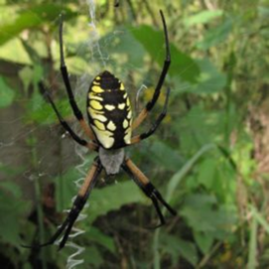
The Gift of Beauty
Interpretation should help people sense the beauty in their surroundings – to provide spiritual uplift and to encourage resource preservation
Notes:
The plants, animals, soil, water, landscape, and even the bugs and snakes all have beauty.
Every person sees beauty differently. When I was leading a group of children on a nature walk, one spotted this “giant, ugly spider!” Several of the kids wanted to kill her. I told them that this spider is a beautiful queen sitting on her webbed throne waiting for food to come to her. I asked them if they would like to feed the queen. We took turns throwing grasshoppers into her web and the attitudes completely changed about this spider. I doubt a single one of those children will ever kill an argiope like this one!

Slide 24
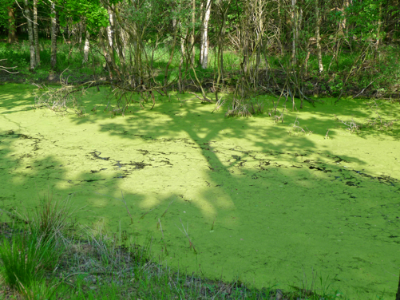
Notes:
Algae or something else?...Look closer, reveal the truth. If you see everything, you see nothing.

Slide 25
The Gift of Passion
Passion is the essential ingredient for powerful and effective interpretation
Notes:
Should not be a problem here because everyone is here because we have passion, show it. It’s amazing how much better people respond to someone that is excited about what they are talking about!
“Interpreters change lives, sometimes a whole busload at one time!” When an interpreter gets visitors excited it makes the visitor want to be this excited too. It also helps with Tilden’s 4th principle of provocation. Your passion can rub off on visitors and provoke them into learning, thinking, or doing more!

Slide 26
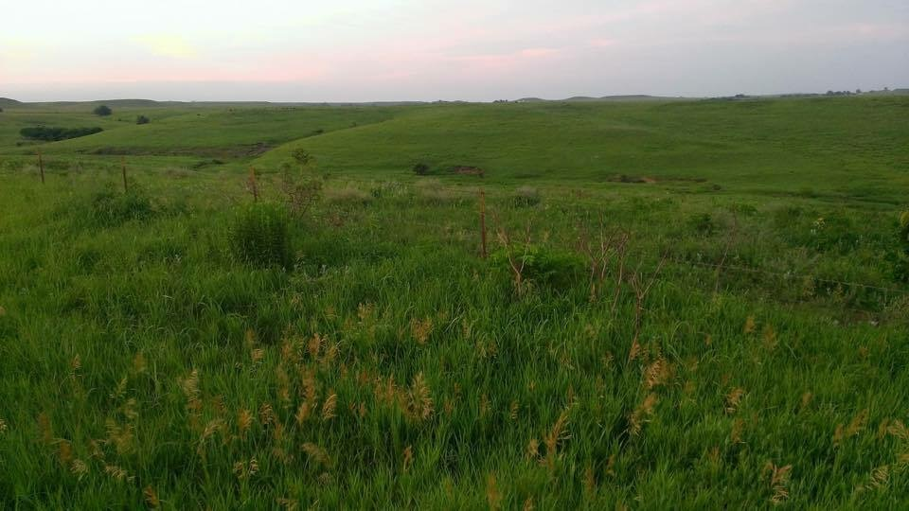
"In the end, we conserve only what we love. We will love only what we understand. We will understand only what we are taught." - Baba Dioum
Notes:
LOVE IS THE PRICELESS INGREDIENT

Slide 27
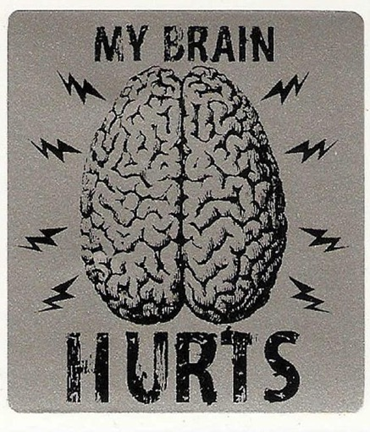
Brain Break!

Slide 28
The Process
The Interpretive Formula
(KR+KA)+AT=IO
KR – Knowledge of the Resource
KA – Knowledge of the Audience
AT – Appropriate Technology
IO – Interpretive Opportunity

Slide 29
Maslow’s Hierarchy of Needs
Developing the Experience
Notes:
Audience management begins with knowing your audience. You can do this by:
1.Arrive ahead of time and visit informally with the group. Always expect early arrivals.
Be prepared to change your technique based on your audience.
2. Make sure basic physiological needs are met – are they physically comfortable? Consider the temperature, water to drink, point out where to find restrooms, etc. Give your “ground rules” such as an overview of the program, what they should expect physically, intellectually, etc. Don’t give too many instructions at one time. Break up the “rules”/expectations so they don’t lose them in the noise.
3. Watch your audience’s body language: are they restless? Talking while you are presenting? Losing interest? You may need to sit and regroup/refocus.
4. Can your audience hear you? Can they see what they need to see to connect with the resource?
5. Model appropriate behavior
6. Looks for ways to include people in your presentation, make them part of the story. Strive to show them they are part of this story.
7. Watch out for passing things around: in small groups, this can go well, but in larger groups it can be problematic.
8. Make sure your audience feels successful. Ask questions that they CAN answer, help them thrive and enjoy the experience.

Slide 30
Developing the Experience
Inventory the resource
Develop a theme and focus all activity on that theme
Select contacts and methods to support the theme
Present your program with confidence and enthusiasm

Slide 31
Themes
“A statement (often expressed in one complete sentence) of what the interpreter wants the audience members to understand and take away with them.”
A theme is a “whole,” a complete idea
Notes:
Have the audience tell you one thing they like about our natural world. Turn that into a theme statement - John uses nature to improve his attitude “Time in Nature May Improve Your Attitude”

Slide 32
Why use themes?
Themes eliminate the tendency to present a collection of unrelated facts, which keeps from overloading the audience.
“People remember themes…but forget facts.” –Sam Ham (1992)
Attention, comprehension, and memory increase if people are given a theme

Slide 33
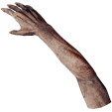
PIGARMTOEJETCAT
PIG ARM TOE JET CAT
This Photo by Unknown Author is licensed under CC BY-SA
Notes:
PIGARMTOEJETCAT= PIG ARM TOE JET CAT Showing people everything without organization and without relating it to other things in your talk, makes understanding much more difficult.
“You have seen nothing because you have seen everything.”-Freeman Tilden

Slide 34
Themes
To gain audience interest:
Write themes as complete sentences with one idea
Use “you”
Present theme in the form of a question

Slide 35
The Process
Steps in theme writing:
Select general topic
“Generally, my talk is about __________”
2. Be more specific and complete
“Specifically, I want to tell my audience about__________”
3. Now complete your theme
“after hearing my presentation, I want my audience to understand that ________”

Slide 36
Examples
“Only ________ can _________
________ ___________!”
Topics—different than themes!
Fire Prevention is the topic
Notes:
“Remember… Only YOU Can Prevent Forest Fires”

Slide 37
Subthemes Support Themes
Notes:
How about Theme: Only YOU can prevent forest fires!
Subtheme: Extinguish your fire completely

Slide 38
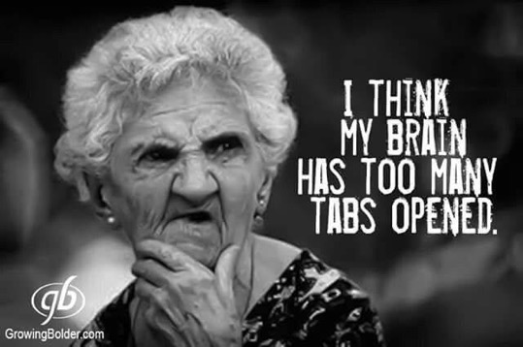
Interpreters must concern themselves with the quantity and quality of information presented.
Focused, well-researched interpretation will be more powerful than a longer discourse.
Notes:
Not only does your interpretation need to be accurate, it also needs to be focused on what you want the visitor to remember. If you open too many tabs, you forget what you had open. People can only remember about 5 (plus or minus 2 or 3) ideas in our short-term memory. Make your info count!

Slide 39
“Through interpretation, understanding; through understanding, appreciation; through appreciation, protection” –Freeman Tilden
Notes:
LOVE IS THE PRICELESS INGREDIENT

