Slide 1
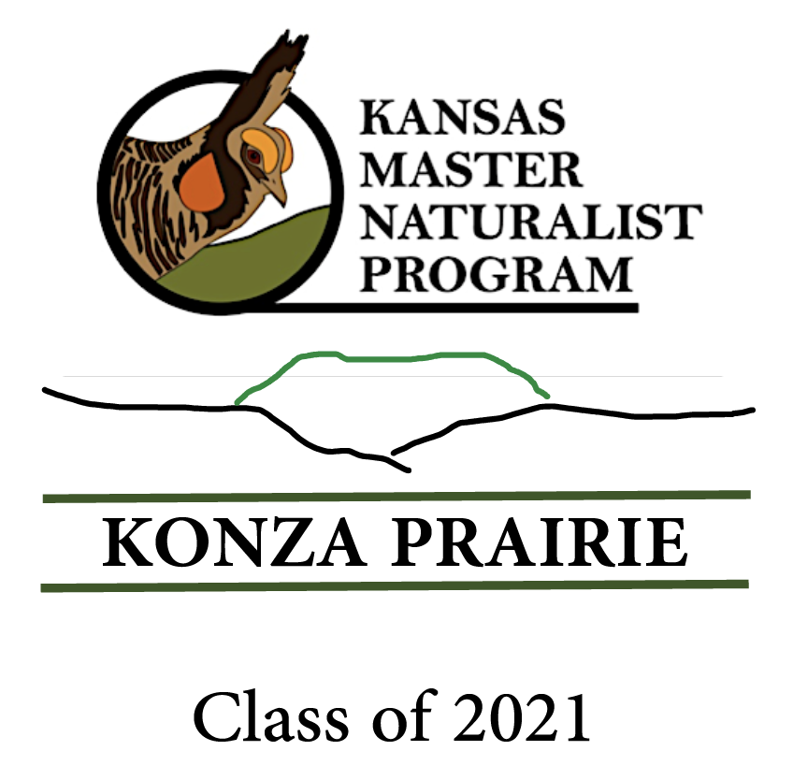
Konza Prairie Chapter

Slide 2
What is the KMN Program?
"The mission of the Kansas Master Naturalist program is to develop knowledgeable and dedicated citizens who are active in promoting awareness, understanding, and stewardship of the natural heritage of Kansas."

Slide 6
Kansas Master Naturalists volunteer their time and expertise throughout the year.
There are over 60 different sites across Kansas that recognize the KMN program and utilize individuals certified as Master Naturalists.
A list of these sites is included in the KMN notebook.

Slide 7
Three chapters of KMN in Kansas
Konza Prairie
Johnson County Extension
Dillon Nature Center

Slide 8
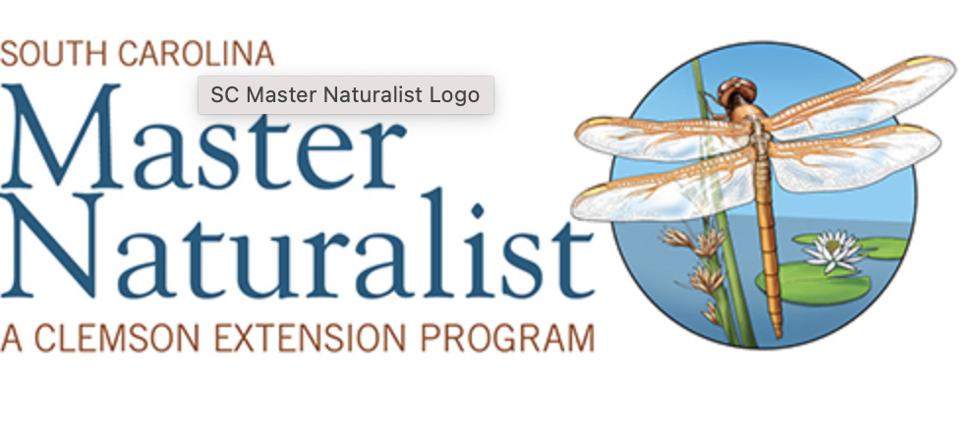
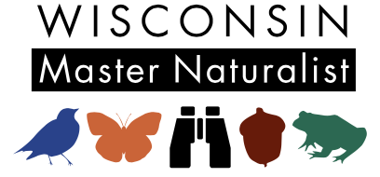
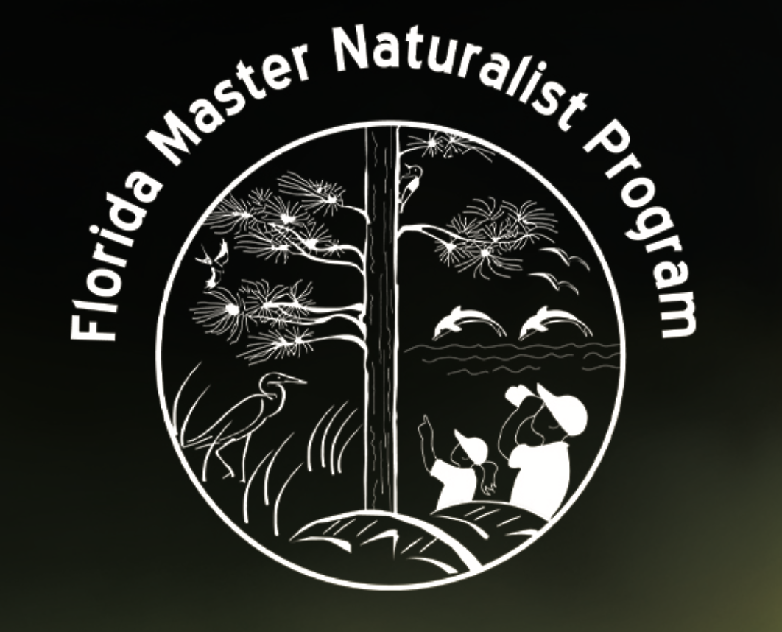
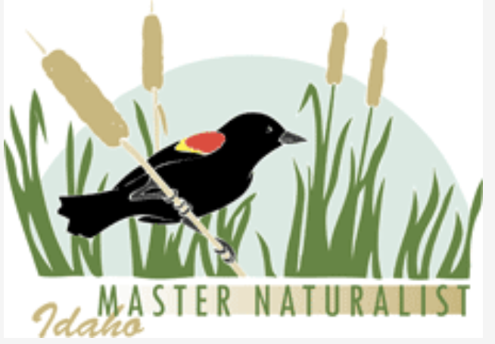
Nationally: Most states have a Master Naturalist Program – all designed to encourage greater understanding and appreciation for the natural world.

Slide 9
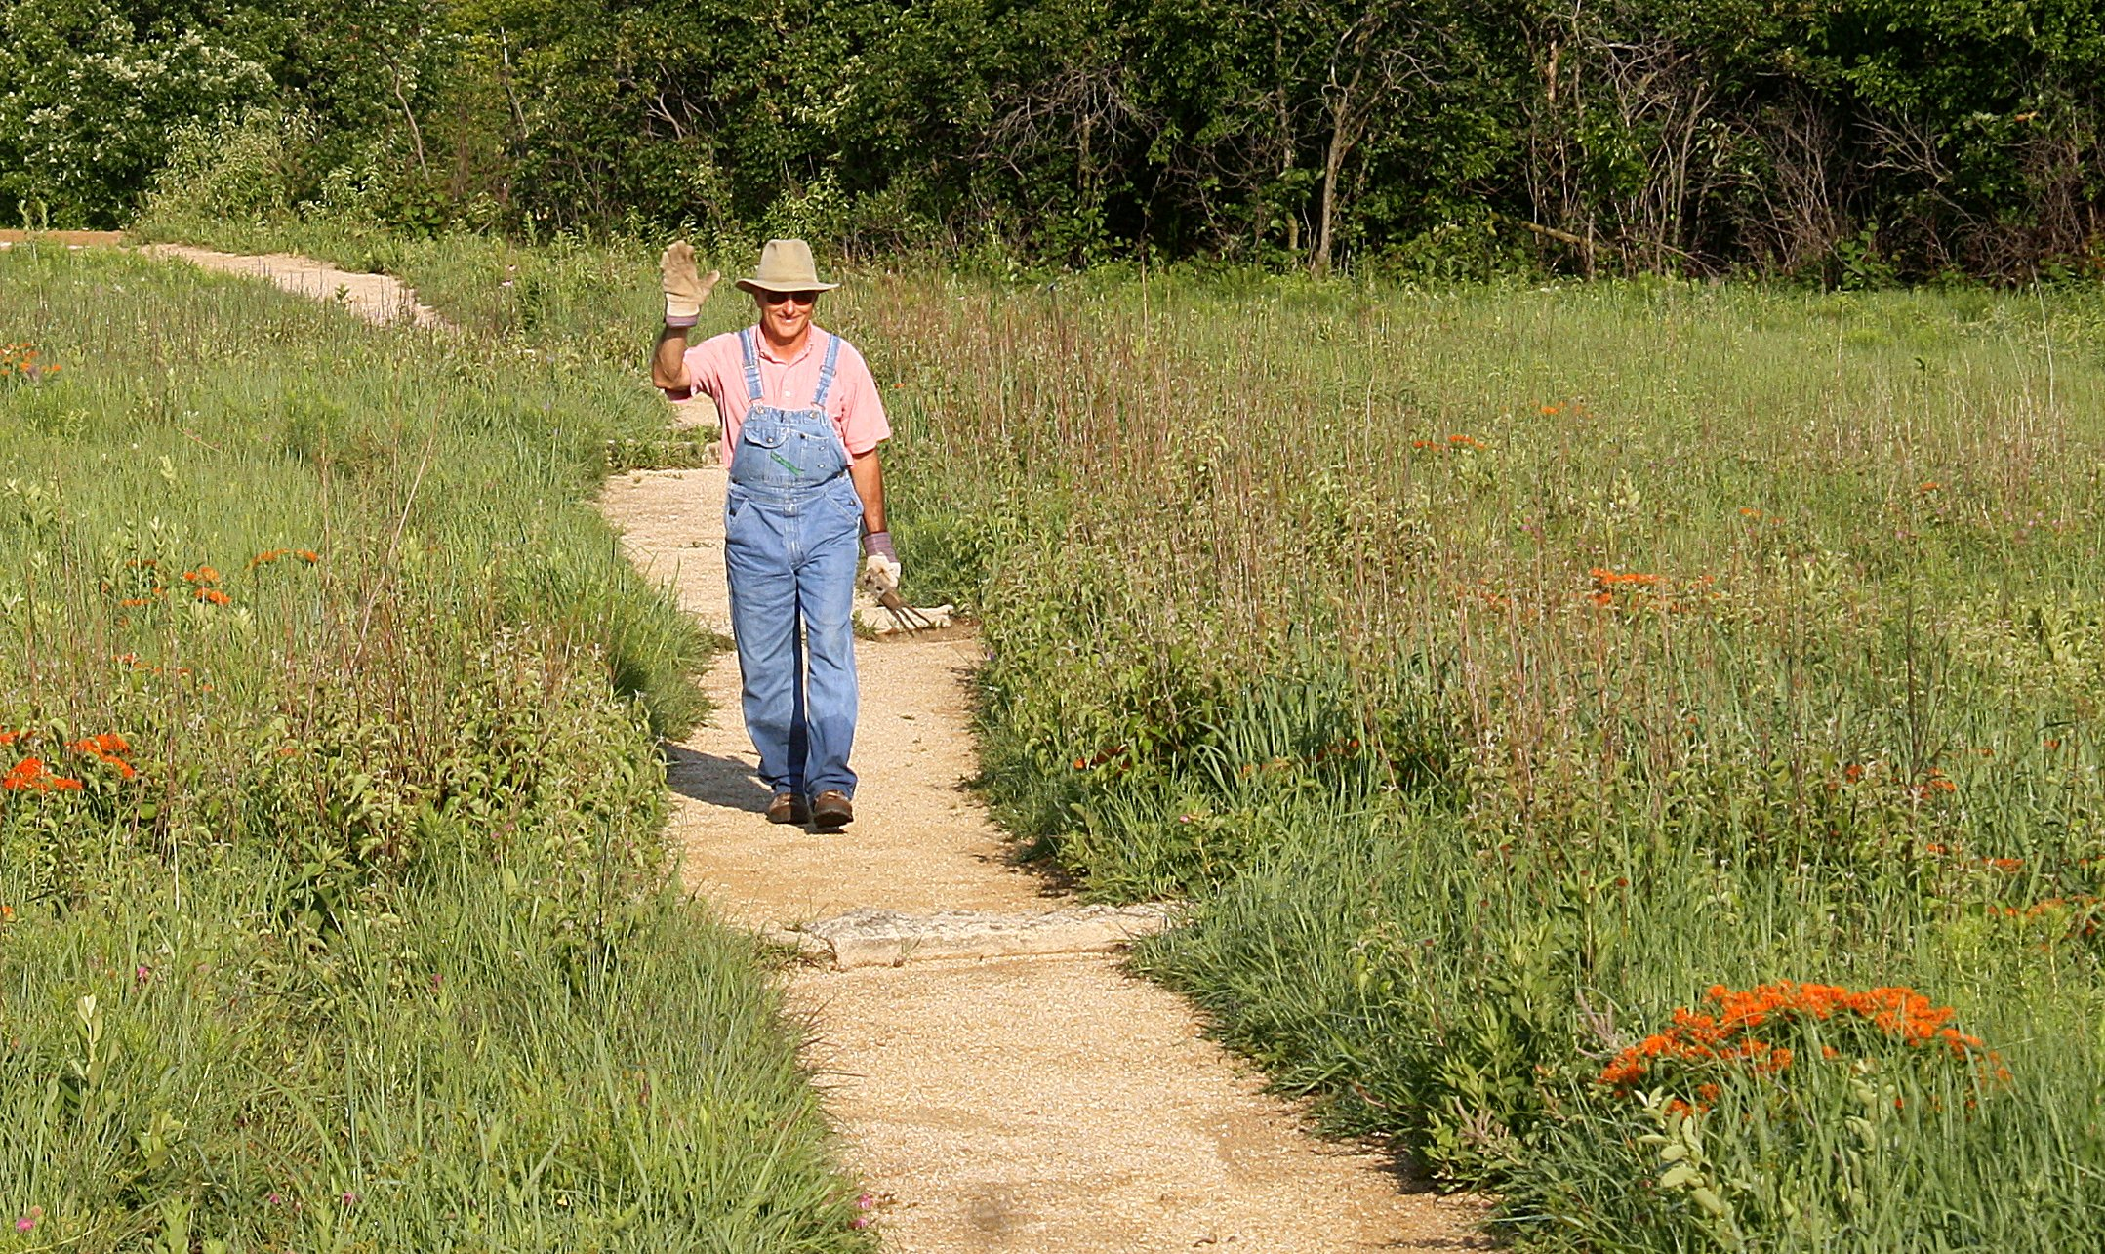
Roles KMN may assume:
Collector of scientific data
Interpreter
Teacher
Advocate
Steward

Slide 10
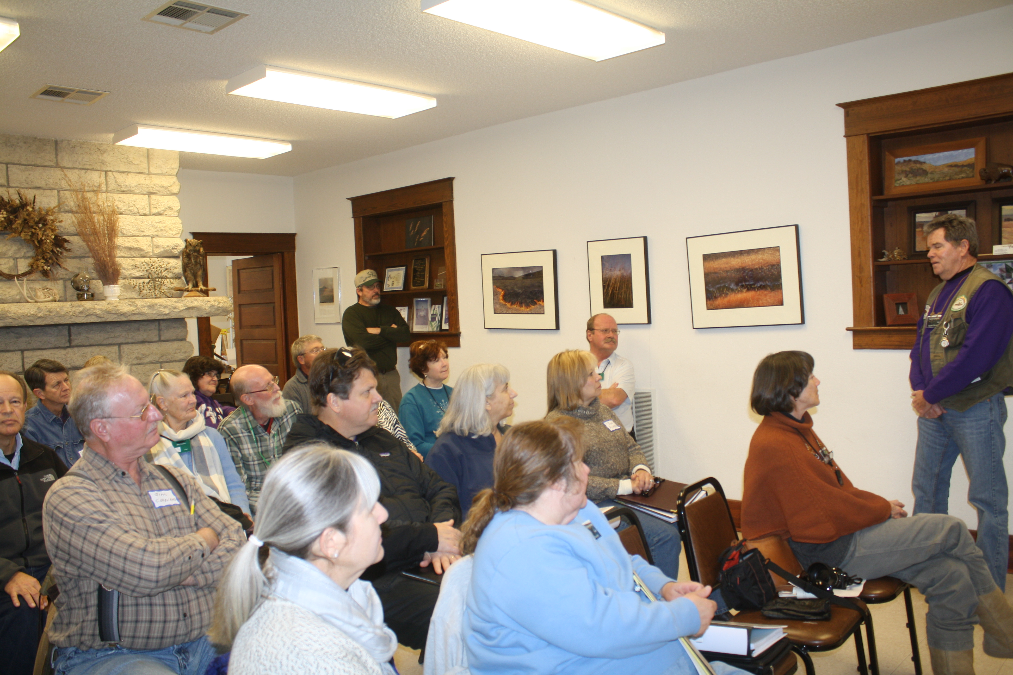
What you get out of it:
Enhance your love of nature through hands-on training and community-based service.
Practice life-long learning and sharing with new people with similar interests.

Slide 11
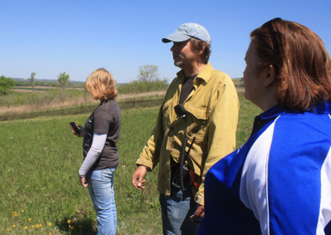
Give something back to nature and your local community.
Learn more about local, regional, and state natural resources and conservation.
Learn from and work side-by-side with experts.

Slide 12
What KMN Training Entails:
Paying $120.00 enrollment fee
same for all KS participants
Attendance at weekly training sessions
February 6th – April 23rd
Donating 30 hours of volunteer service within 2 years of initial training

Slide 13
What you receive:
KMN notebook
40 hours of training from area experts
Guidance and direction on volunteering
Friendship and a sense of belonging

Slide 14
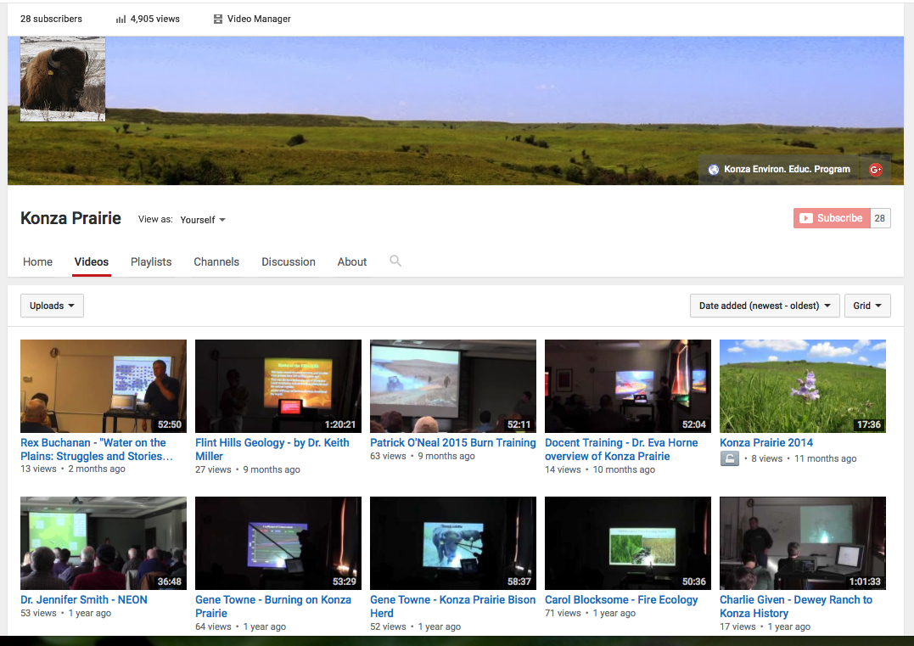
If you can’t attend some of the sessions…
Zoom link is available
I video-record the speakers and place their talks on the Konza Prairie Channel on YouTube.

Slide 15
Reporting your hours:
Right now: call or email the KEEP office
Keeped@ksu.edu
Report the following:
Date of activity
Where the activity took place
Number of hours served
Number of people contacted

Slide 16
Log of your hours

Slide 17
Topics covered during KMN training:
Interpretation
Ornithology (study of birds)
Entomology (study of insects)
Ecology/Weather & Climate
Ichthyology (study of fishes)
Mammalogy (study of mammals)
Geology & Soils
Botany (study of plants)
Herpetology (study of reptiles and amphibians)

Slide 18
Training schedule
Your training will continue every Saturday morning from February 6th – April 2nd.
You will then have time to garner your 30 hrs. of volunteer time over the spring, summer and early autumn.
KMN graduation (for those who are done with hours) with the presentation of name badges and certificates is scheduled for September, 2021.

Slide 19
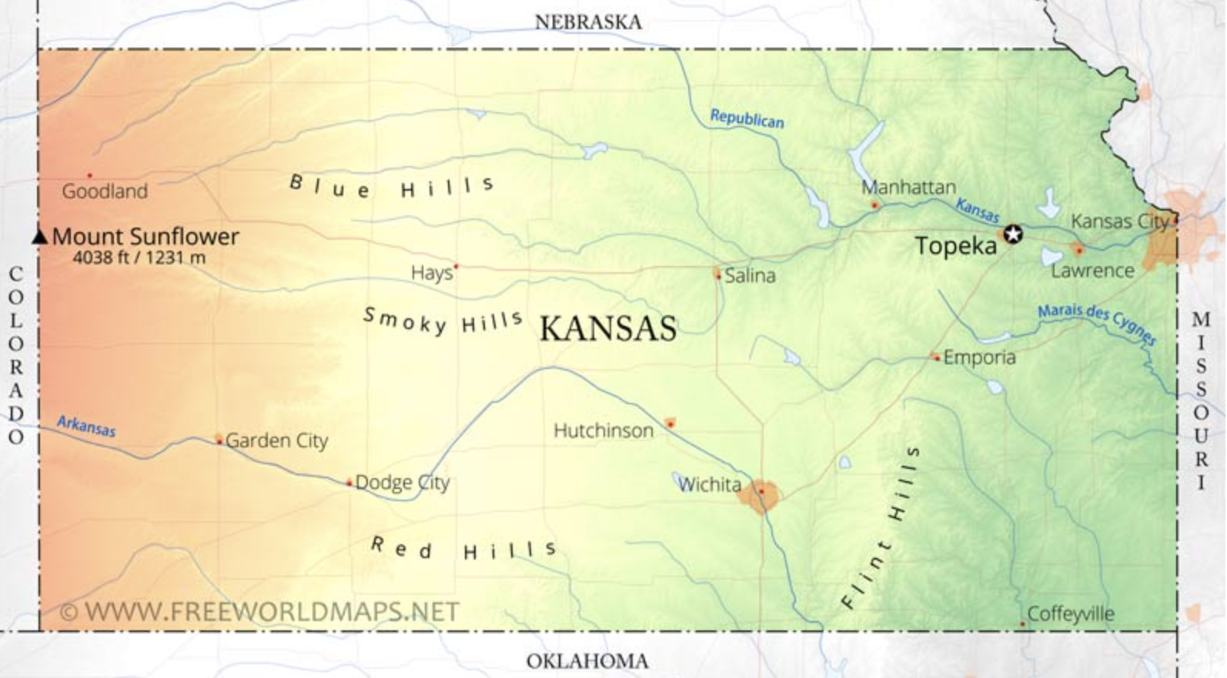
Kansas Master Naturalists
The program covers the entire state
We’ll be looking at nature in Kansas

Slide 20
Distribution of living things…
Living organisms need:
Food
Water
Shelter
Space
Different species have different requirements
Knowing those requirements for a species will enable you to understand, and perhaps locate that species.

Slide 21
Space
We start with “space”
Habitat
Range
Territory
What things affect where different organisms live?

Slide 22
The central location of Kansas makes it likely to have a large number of eastern, western, northern, and southern species – at least occasionally.

Slide 23
Precipitation

Slide 24
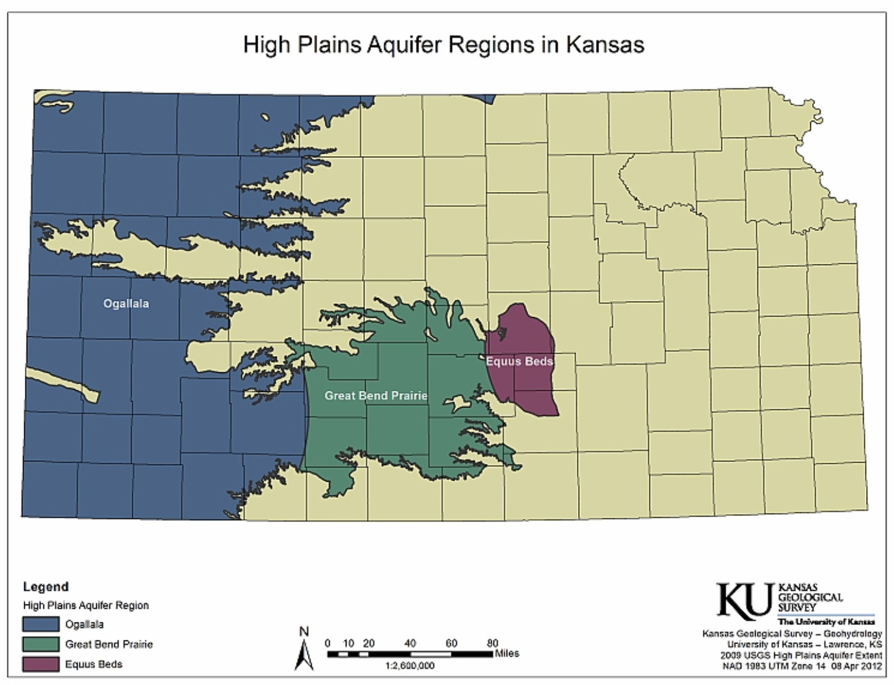

Slide 25
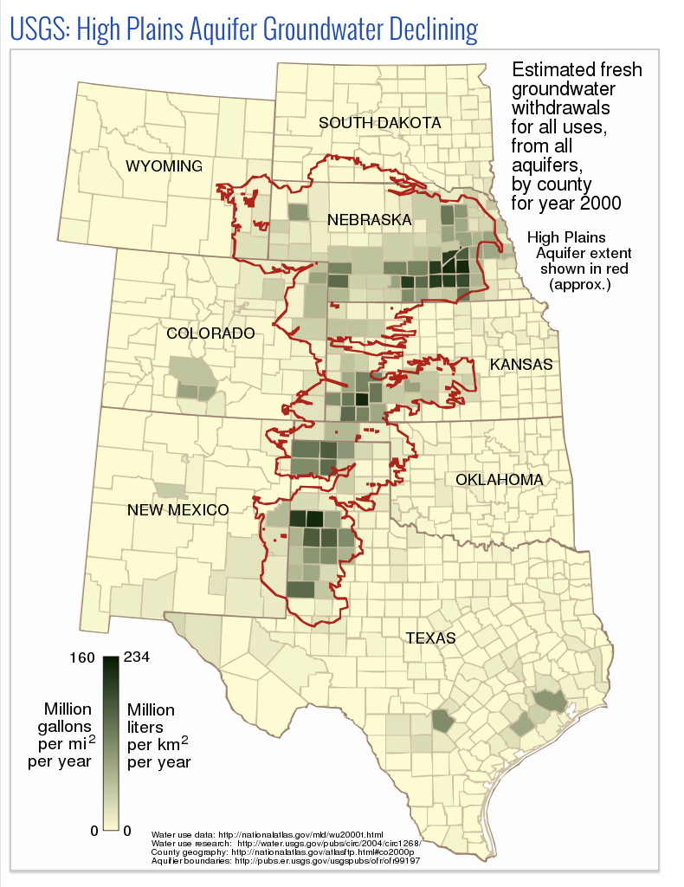

Slide 26
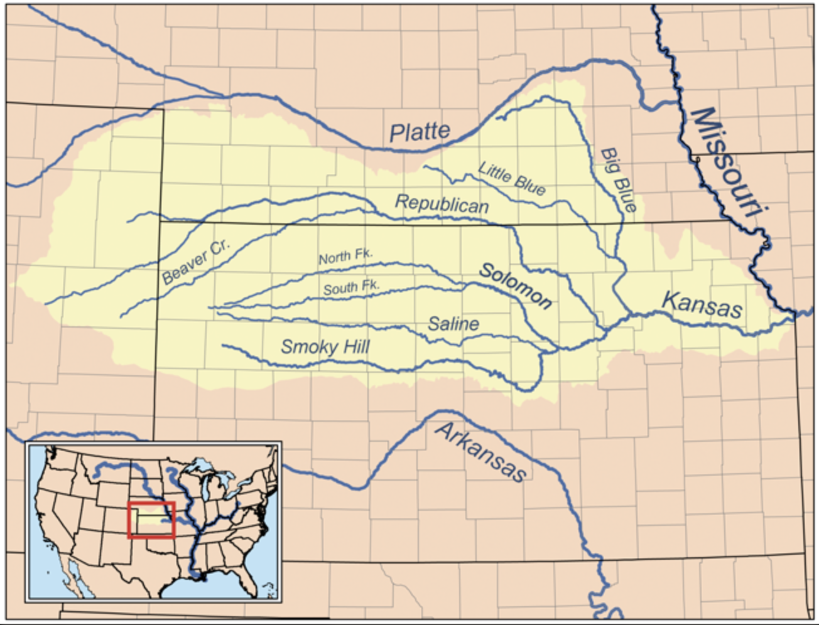

Slide 27
Physiography of Kansas
Physiography = physical geography
11 broad regions in Kansas

Slide 28
Cuesta (kwesta) = a ridge with a gentle slope (dip) on one side and a steep slope (scarp) on the other.

Slide 29
Geology

Slide 31
Elevation

Slide 32
Elevation
Mount Sunflower (4,039’) 2. Liberal 3. Geographic center of the U.S.
4. Great Bend 5. Wichita 6. Topeka 7. Lowest point in KS – Coffeyville (679’)

Slide 33
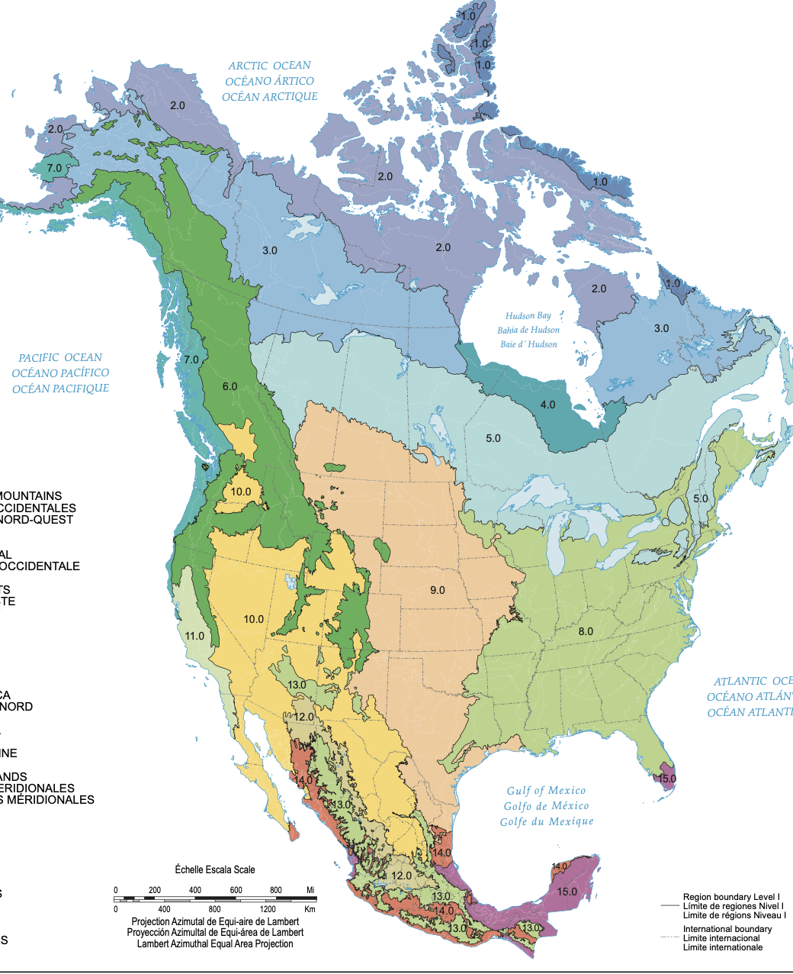
Ecoregions
Ecoregion = a major ecosystem defined by distinctive geography, solar radiation (latitude), and moisture.
Level I Ecoregion
- 12 in the U.S.

Slide 34
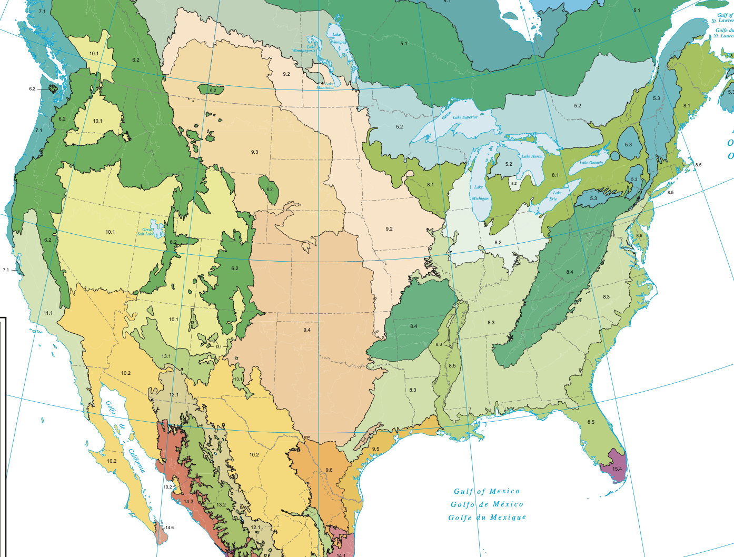
Light tan = temperate prairie
Dark tan = semi-arid prairie
Level II Ecoregion – 25 in the U.S.

Slide 35
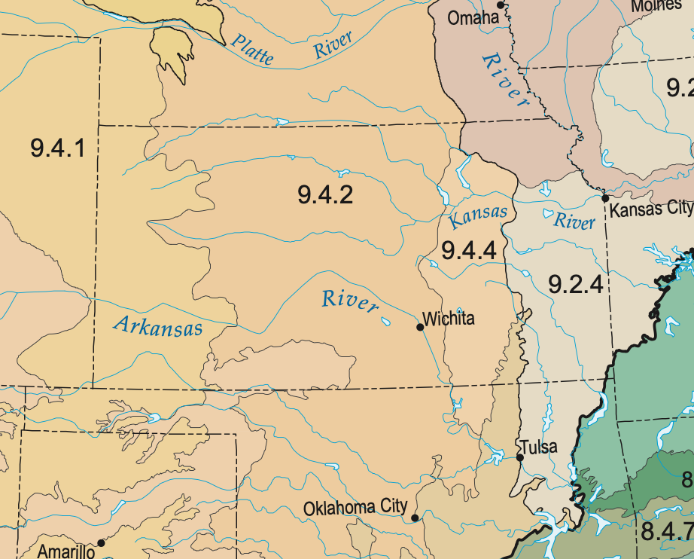
Western Corn Belt Plains
High Plains
Central Great Plains
Central Irregular Plains
Flint Hills
Southwestern Tablelands
Ozark Highlands
Cross Timbers
Level III Ecoregion – 105 in the U.S.
8 in Kansas

Slide 36
Dominant vegetation in the different regions of Kansas

Slide 37
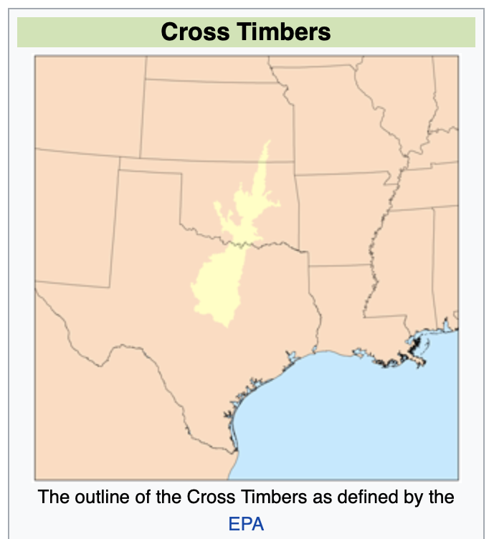
Dominant vegetation = Post Oak, Blackjack Oak
Serves as the western habitat boundary for many mammals and insects
Serves as the line between forest and prairie

Slide 38
Types of prairie in Kansas

Slide 39
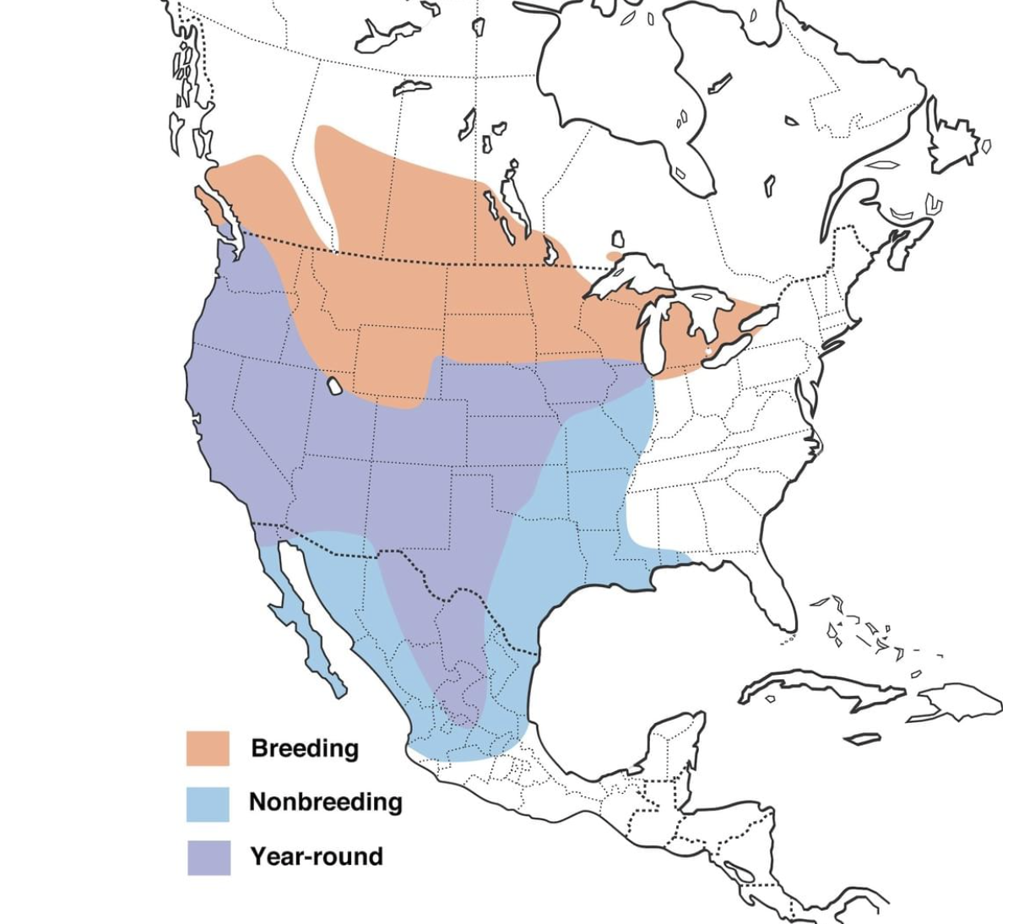
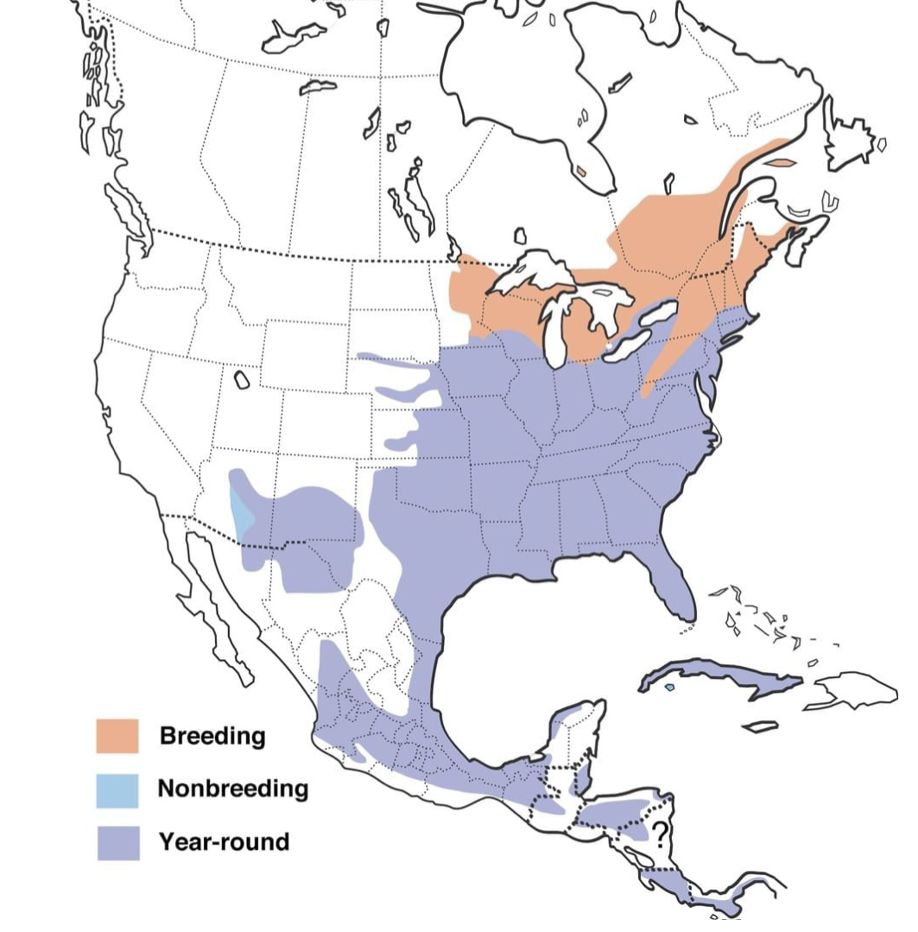
Meadowlark Ranges

Slide 40
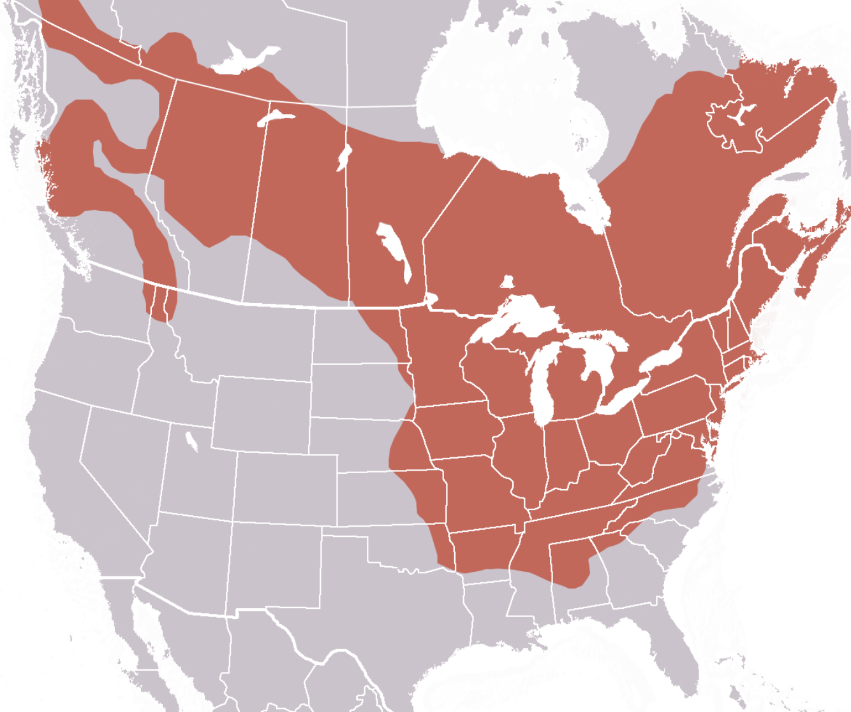
Range of the Woodchuck

Slide 41
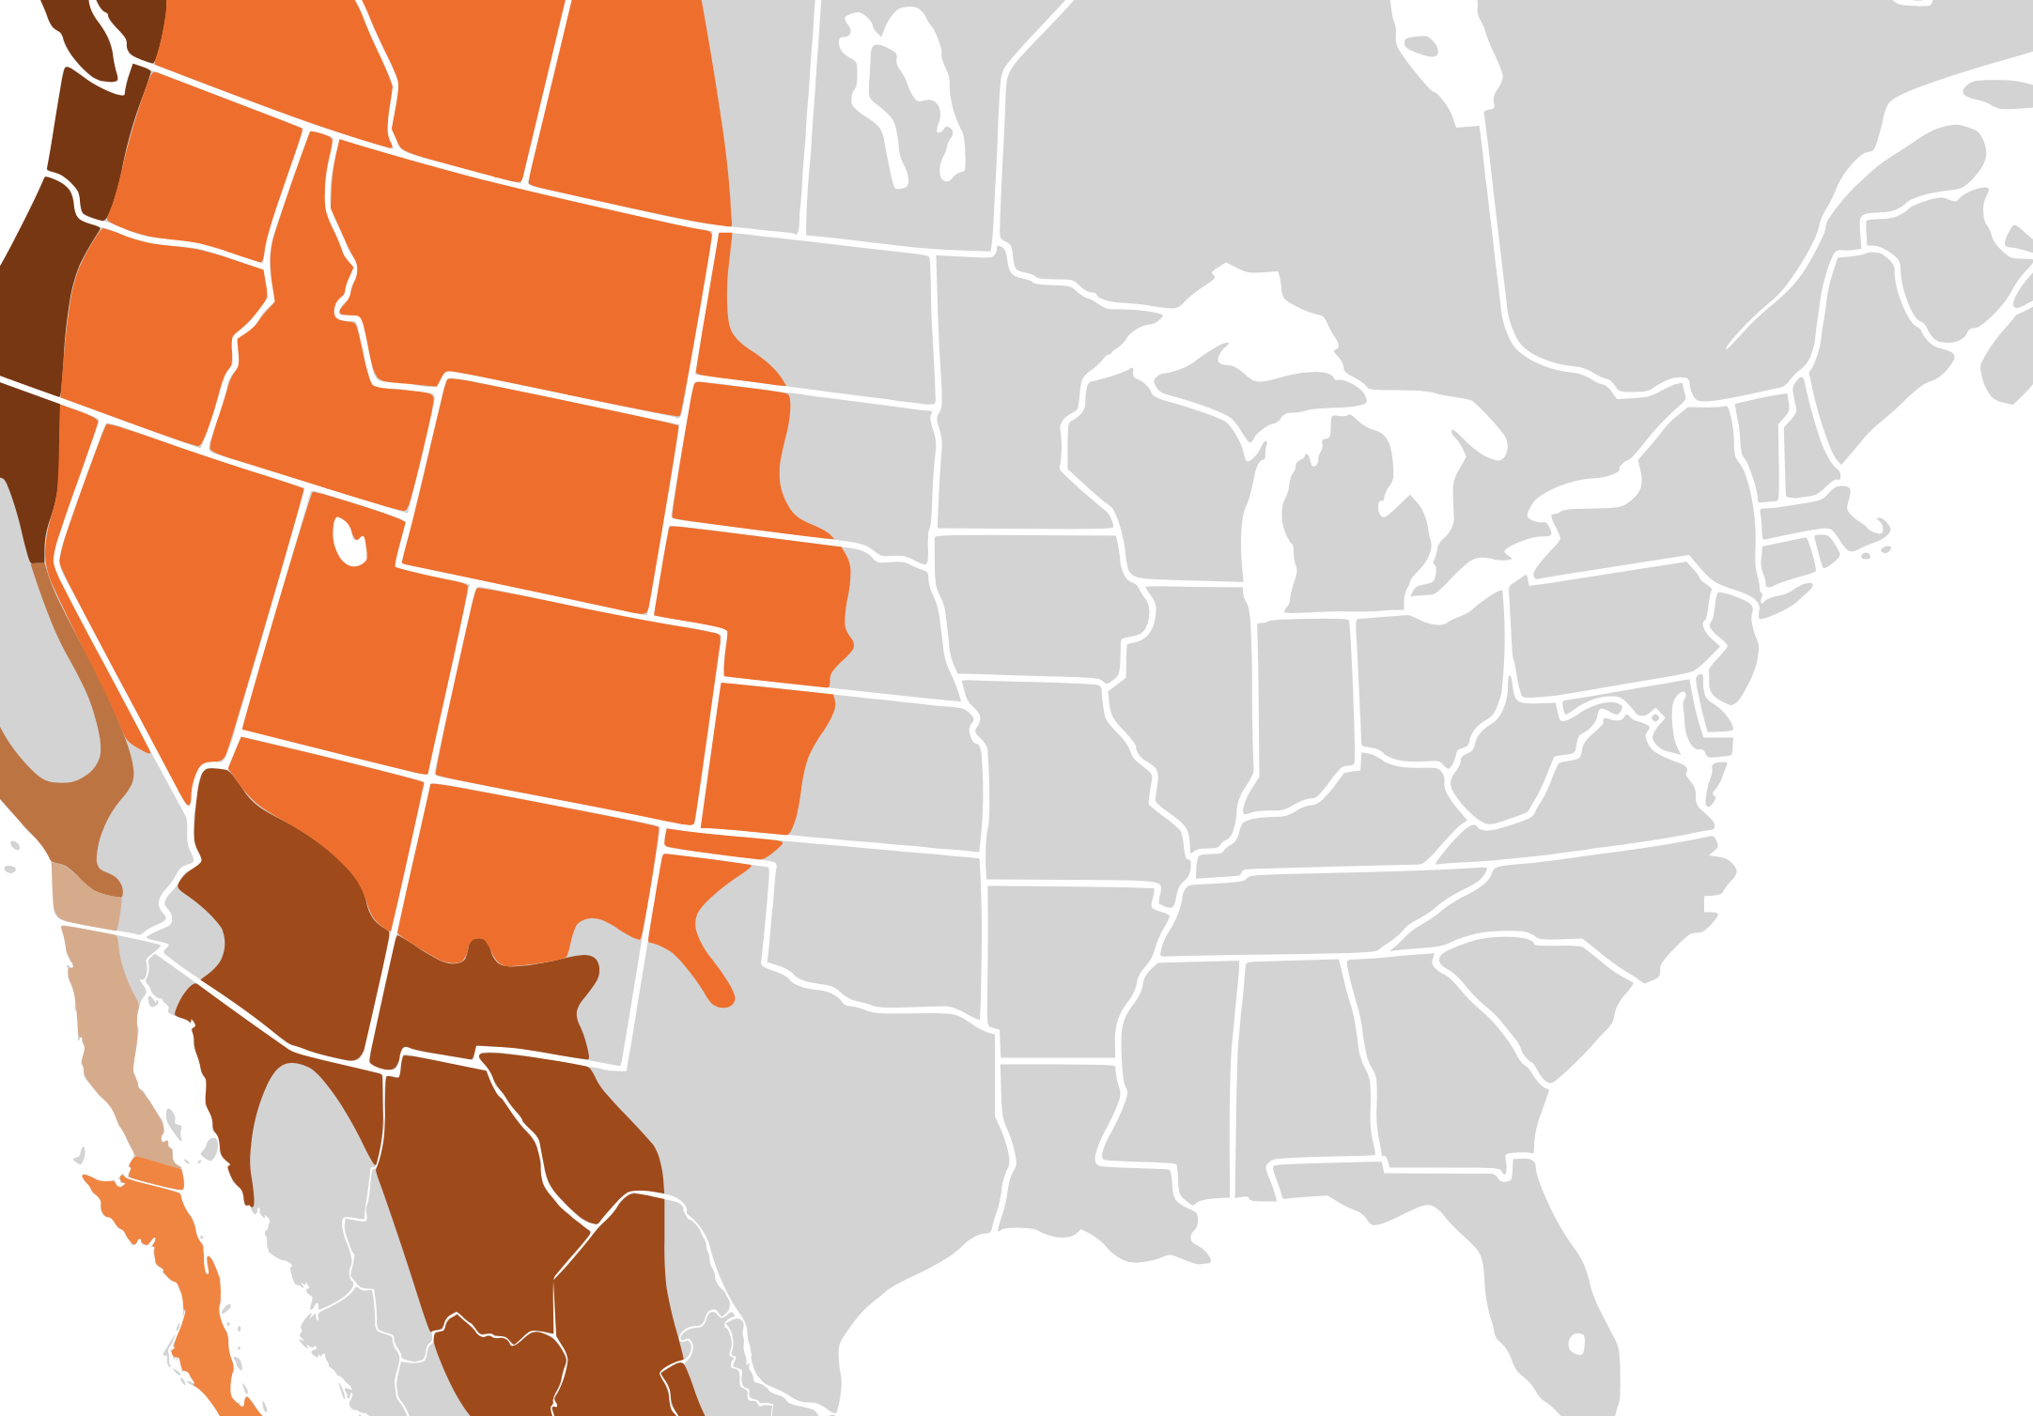
Range of the Mule Deer

Slide 42
Next week we’ll learn about where in Kansas we can see the different ecoregions
We’ll also learn how to effectively communicate what we know and see to others - Interpretation

