Slide 1
Fire on the Prairie

Slide 2
1.
Have you ever seen a prairie fire?
Do you think fire hurts the prairie?
Notes:
TEACHER HELP: Fire doesn’t hurt the prairie, it helps it! We’ll learn more about this as we get further in the presentation.

Slide 3
Video of fire on the prairie
2.

Slide 4
Fire can look scary and like it’s hurting the prairie, but it isn’t!
3.
Can you think of a reason why fire could be good for a prairie?
Notes:
Answer: because it removes old, dead plants letting the rain and sunshine hit the soil where the roots of the plants can warm up quickly and absorb rain efficiently – and grow rapidly! Fire also helps to control the shrubs and trees that can take over a prairie if we don’t burn it often enough.

Slide 5
Let’s find out why fire is important to a healthy prairie:
4.

Slide 6
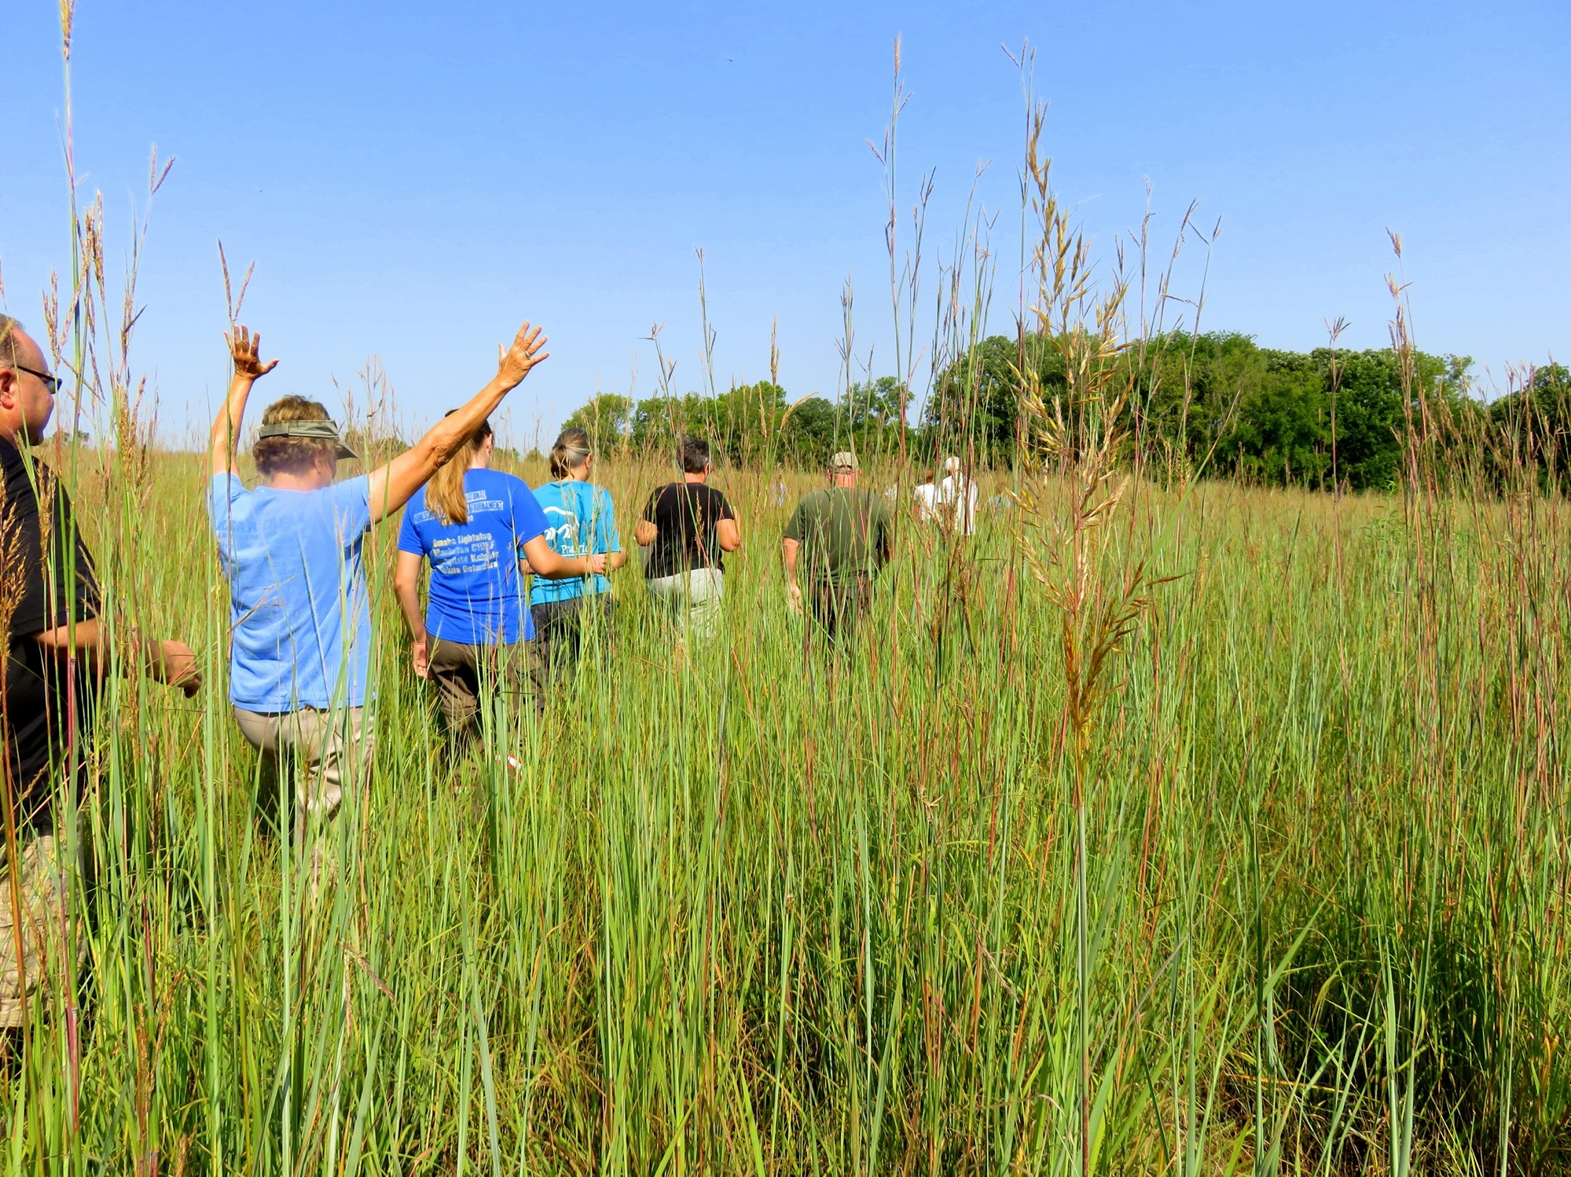
Prairie plants look big…BUT MUCH MORE of the plant’s body is underground than what we see above ground
5.
Notes:
TEACHER HELP: Prairie plants have tubers (like potatoes) and rhizomes (like ginger) that store food and water for prairie plants. Plus, they have LOTS of really great roots that absorb water fast!
Approximately 75-80% of the prairie’s body is underground. We only see a small amount of the prairie’s body when the grass leaves grow above the soil.

Slide 7
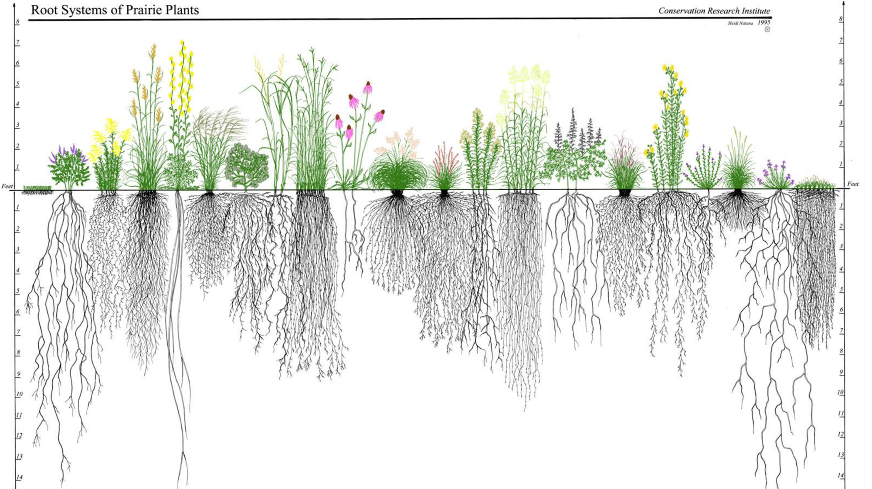
Prairie plants have very long roots and underground parts that can store food and water
6.
Notes:
TEACHER HELP: Most prairie plants have “fibrous roots” rather than tap roots. Fibrous roots are dense and packed into the first 12” of soil. There, they can quickly and efficiently absorb any rain when it falls. Plants with taproots aren’t as good at absorbing the rain quickly. Trees and shrubs have taproots and don’t usually do well on a prairie – were the rain is sporadic and not predictable.
Think of “sod” – the thick prairie soil was held together by the plant’s roots. When the sod was cut, the prairie was lost.

Slide 8
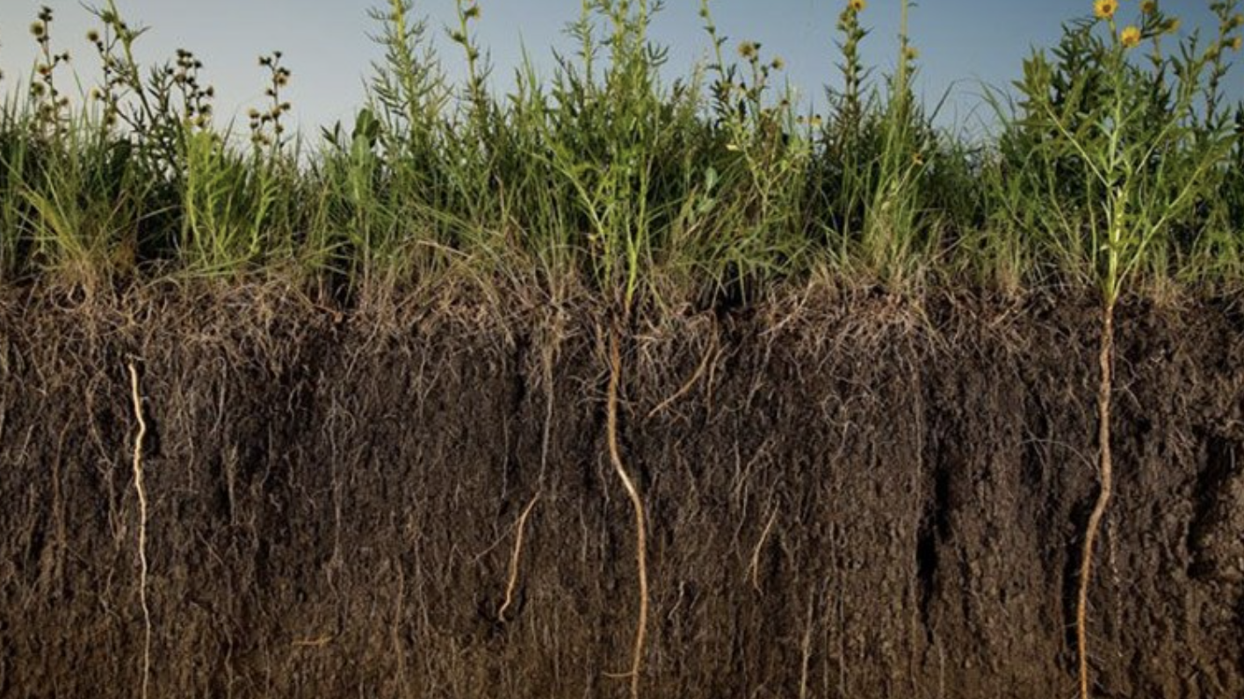
Those long prairie roots look like this
7.
Notes:
TEACHER HELP: All prairie grasses will have thick roots in the first 12” of soil and many will have long roots that extend deep into the soil – if the soil is deep enough to support those roots.

Slide 9
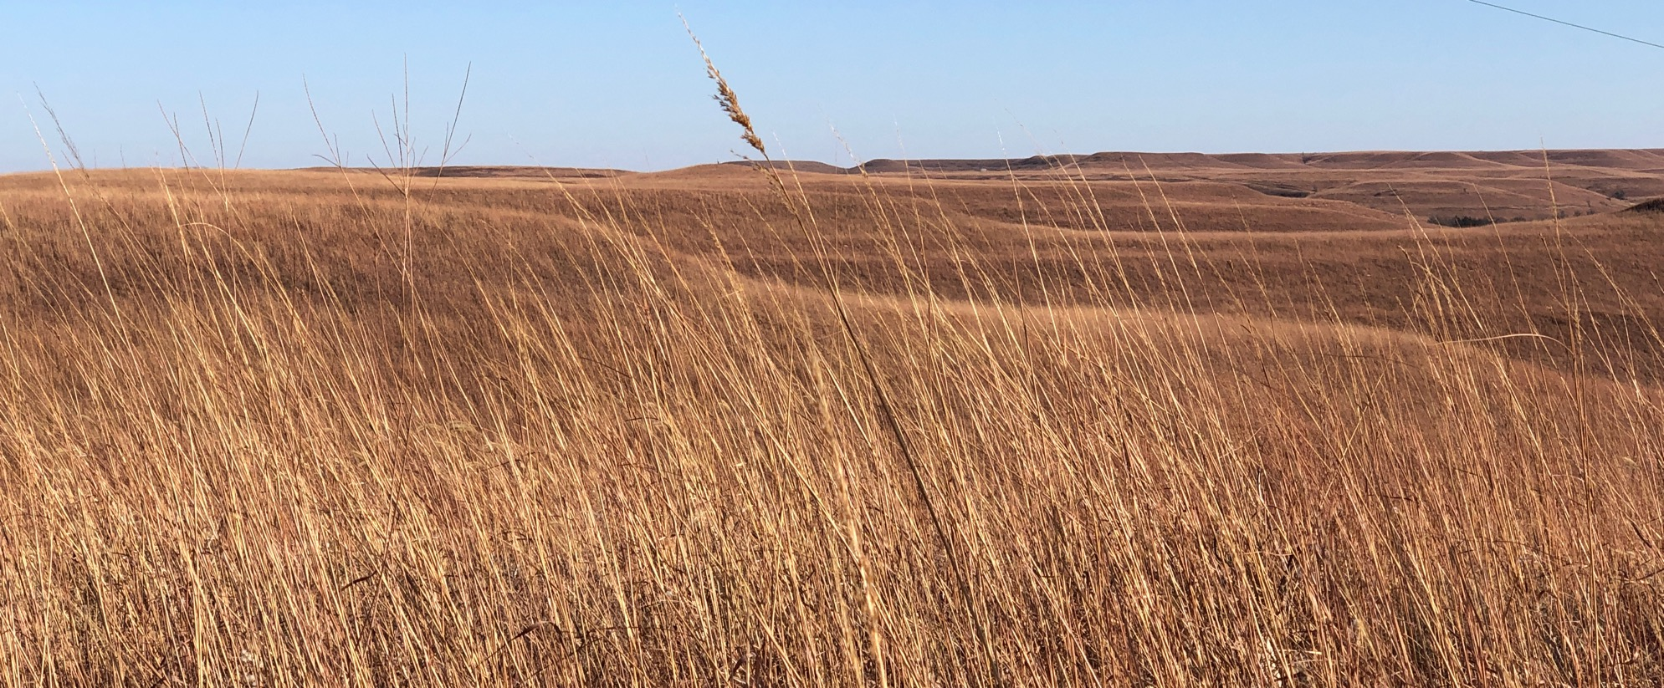
In the winter, the plant parts that are above ground turn yellow and are dead.
8.
Are the prairie plant parts that are underground dead?
Notes:
Answer: Prairie plants are very much alive below the soil – even during the winter!

Slide 10
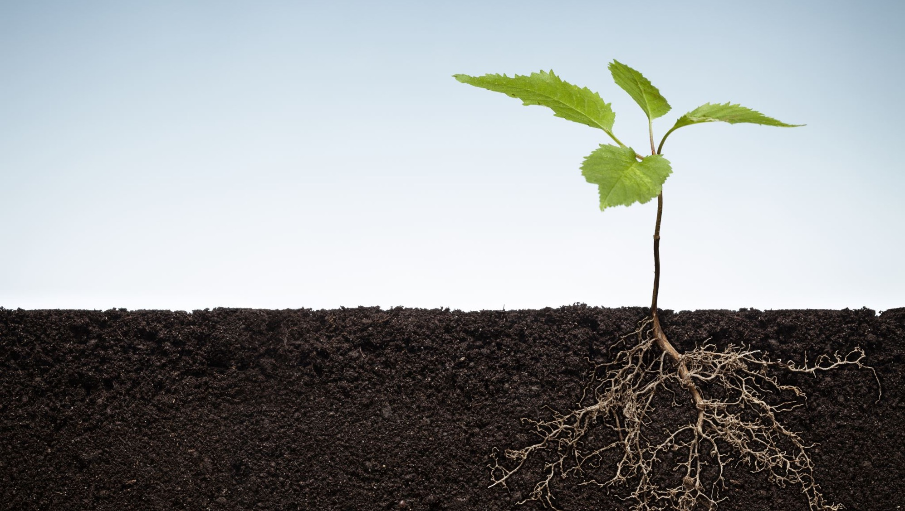
The underground roots and stems are still alive!
9.

Slide 11
When the prairie is burned, the dead parts that are above ground are the only things that burn. The parts below the ground are unharmed.
10.
Draw what you think the prairie looks like above ground and below ground AFTER a fire
Notes:
TEACHER HELP: The pictures should have nothing but black char above the soil and lots of roots and just about anything they can think of still alive below the soil.

Slide 12
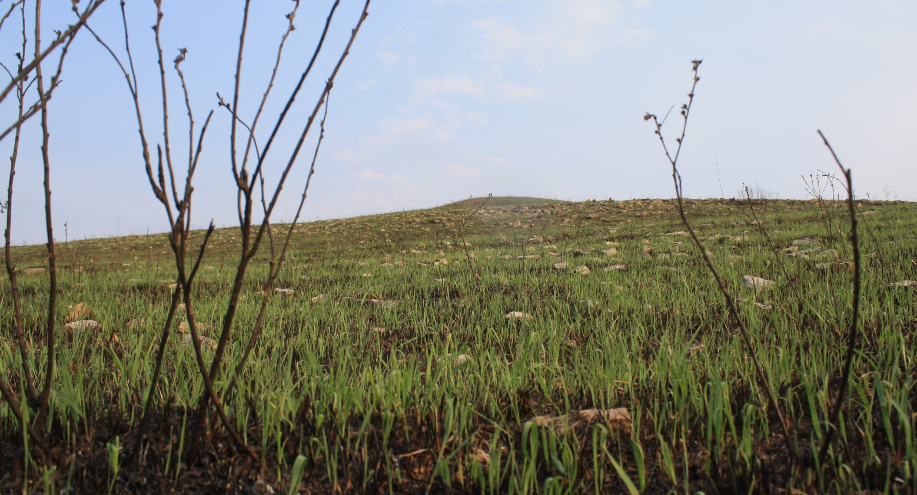
11.
Fire helps to start new growth by allowing rain and warm sunlight to reach the soil and the roots.
9.
Where did the new, green plants come from?
Notes:
Answer: new growth comes from the underground storage structures. Very few prairie plants germinate from seeds.

Slide 13
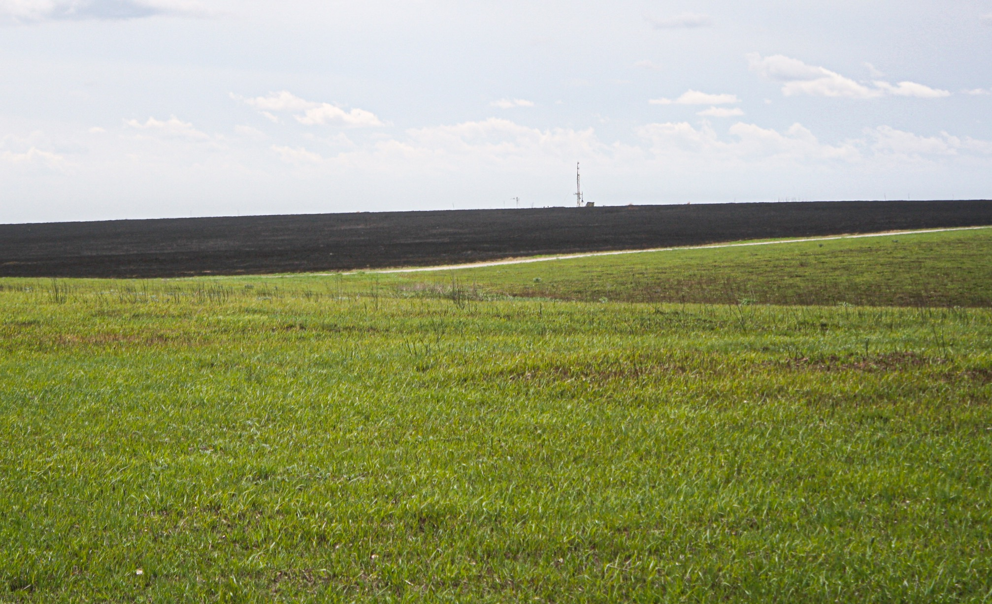
12.
Grass grows FAST after a fire!
How did the new plants get so large so quickly?
Notes:
TEACHER HELP: This is what the prairie looks like about 2 weeks after it is burned. Note the comparison of the foreground to the background that was burned only a couple of days prior to the photo.
Answer: the grass grows quickly because it doesn’t have to start from seeds. Most of the prairie plants DON’T start from seeds – they start from underground roots and stems that store food and water and are able to grow quickly in the spring.

Slide 14
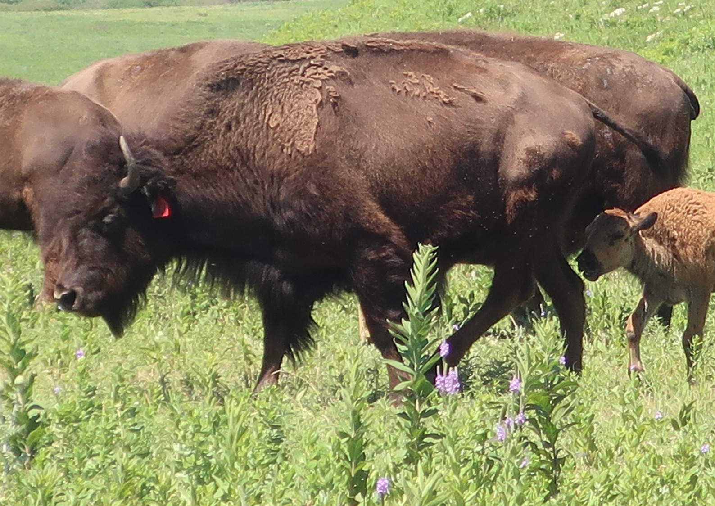
13.
New green grass – without any of the old, dead stems – is yummy!
Bison love the new green grass that grows after a fire.

Slide 15
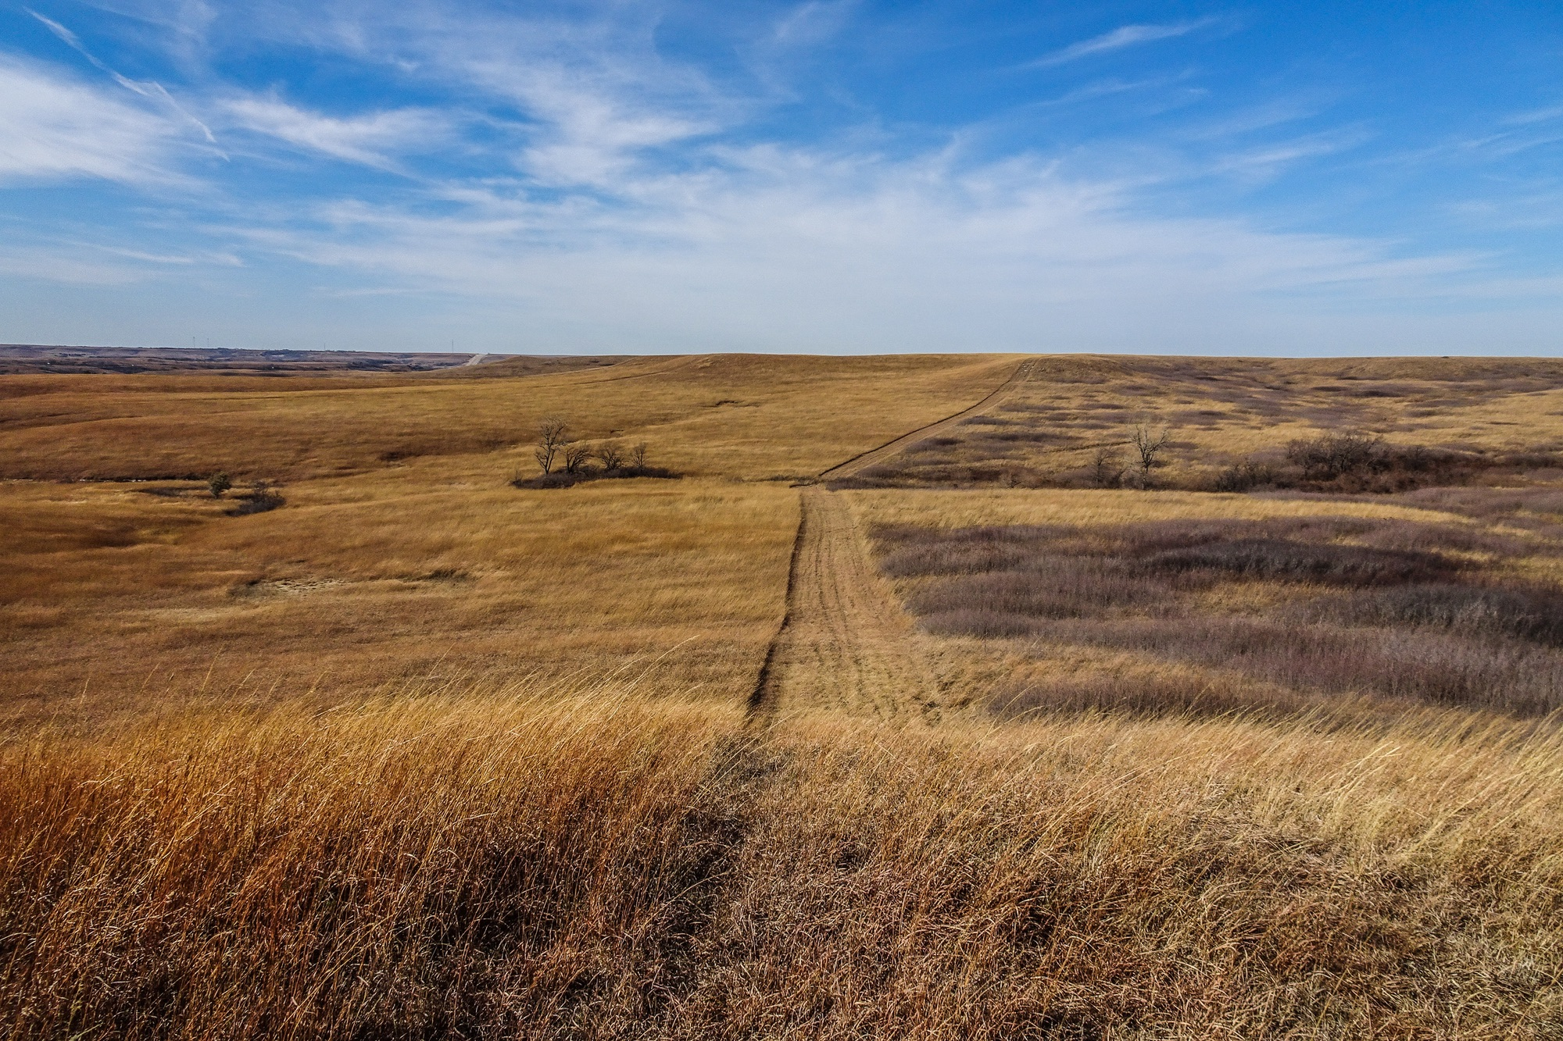
Fire also helps to kill shrubs and trees.
14.
Lots of brown sticks = shrubs
= BAD
This prairie is burned every 2 years
This prairie is burned every 4 years
Notes:
TEACHER HELP: The prairie needs to be burned at least every 2-3 years to keep the invading shrubs out. This photo clearly shows that burning every 4 years is not sufficient at keeping the shrubs away.

Slide 16
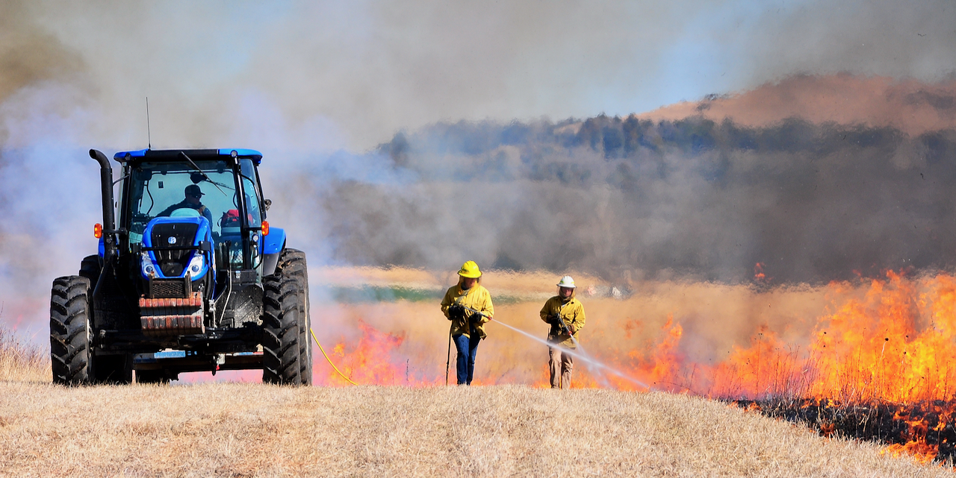
15.
The prairie needs to be burned about every 2-3 years to stay healthy
13.

Slide 17
16.
The next time you smell smoke from prairie fires you’ll know why the prairies need to be burned!

Slide 18
Next – we’re going to learn about rocks and how they saved the prairie!

Slide 19
Author:
Jill Haukos
Konza Environmental Education Program
Konza Prairie Biological Station
Manhattan, KS
© 2023

