Slide 1
How Rocks Saved the Tallgrass Prairie

Slide 2
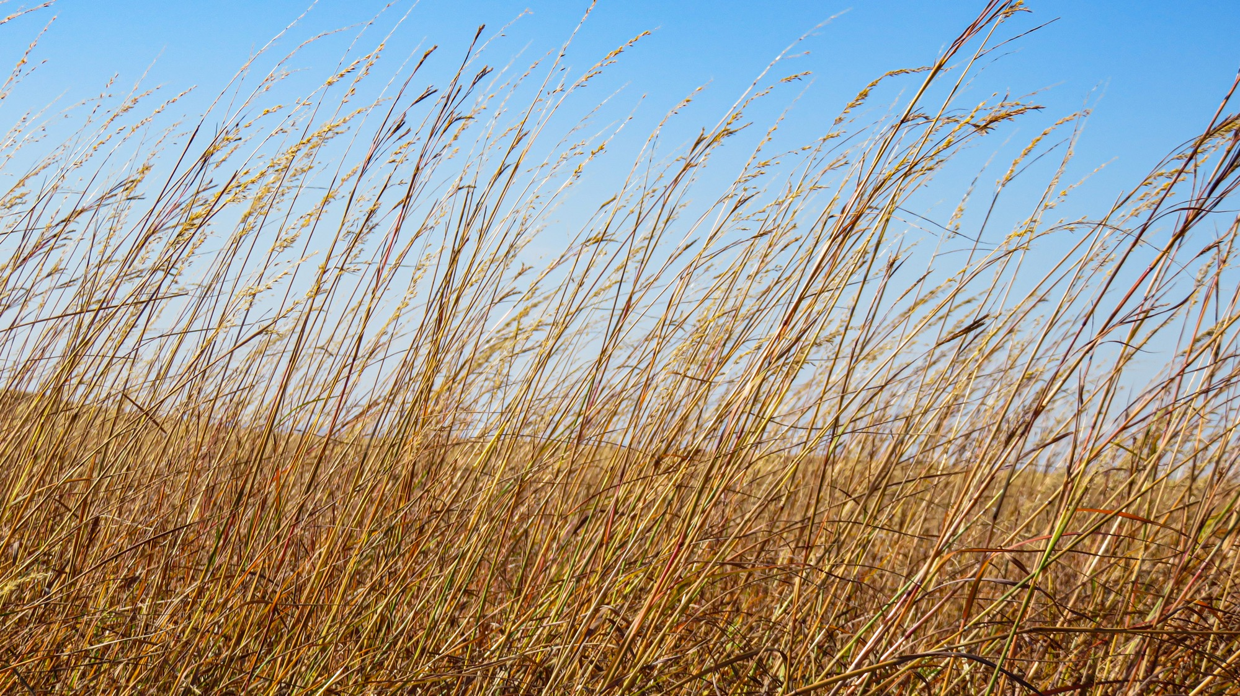
The tallgrass prairie is a part of the United States where the grass can grow VERY tall!
1.

Slide 3
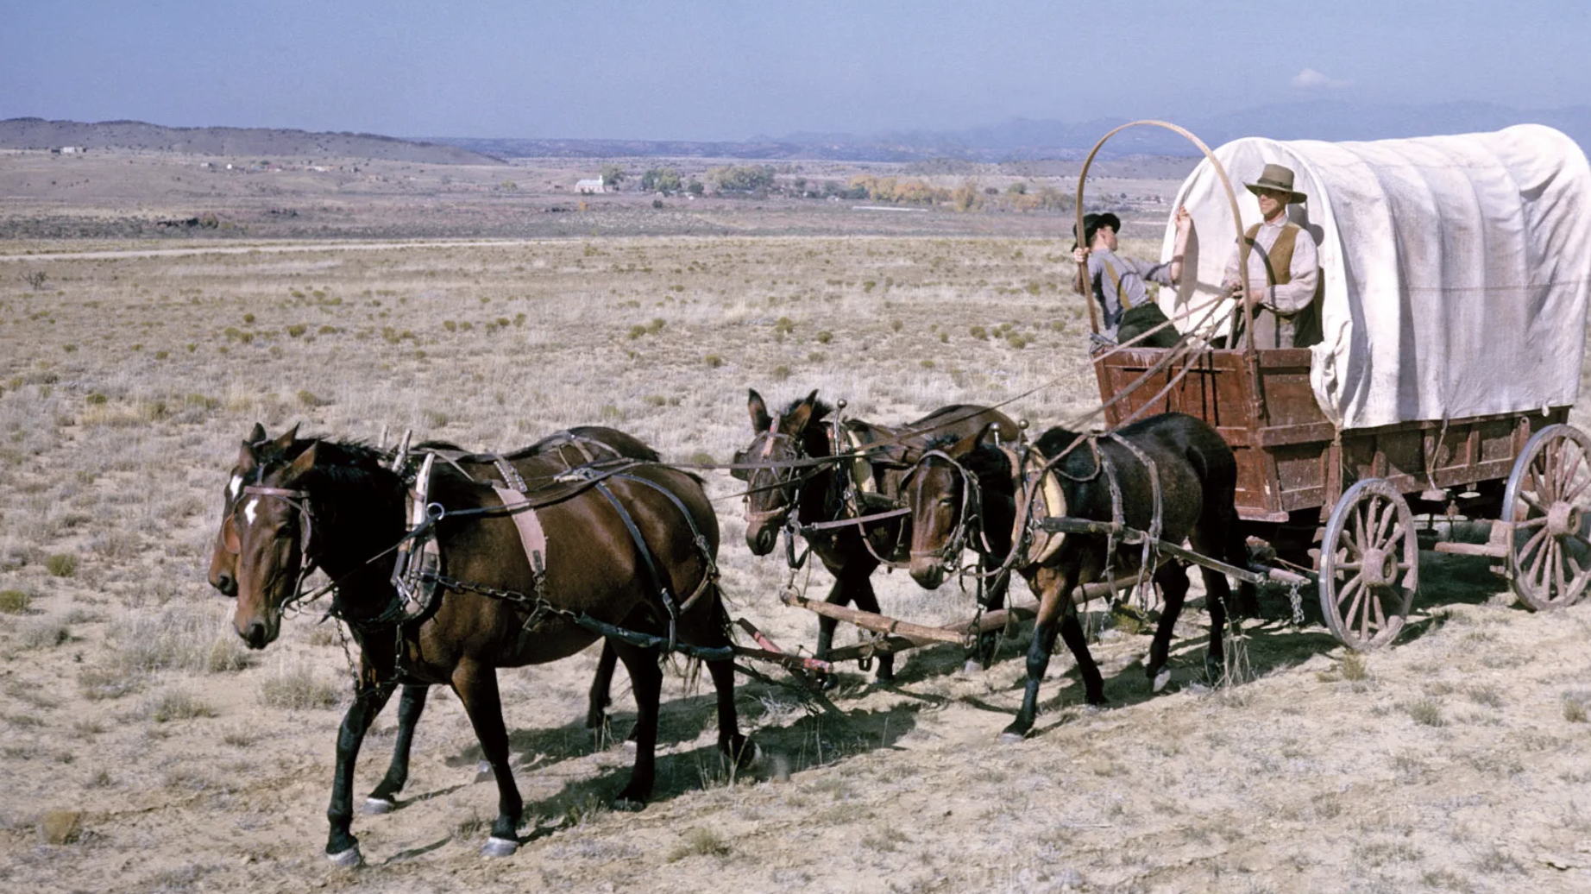
As the prairie became home to more people, they changed the land.
2.
How do you think the settlers changed the land?

Slide 4
Most of the tallgrass prairie was turned into farm fields – to grow corn and soybeans
3.

Slide 5
But, not all of the tallgrass prairie could be plowed. It was just too rocky!
4.

Slide 6
These are the Flint Hills!
5.
These hills are in Kansas and Oklahoma
They have very rocky soil – that can never be plowed

Slide 7
6.
The Flint Hills
Most of the light green land was prairie – it has been plowed into farm fields

Slide 8
Here are the Flint Hills - can you see the layers or ripples in the hills?
7.
These are layers are made up of two different kinds of rock….

Slide 9
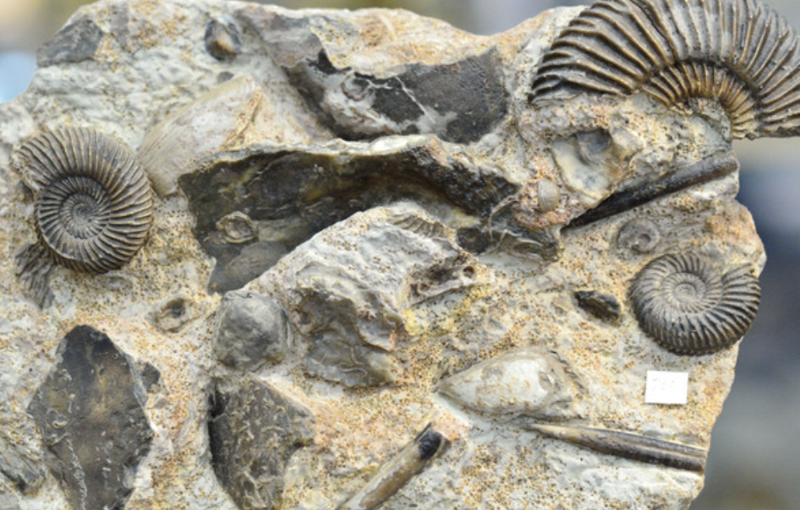
One type of layer is of white rock, called “Limestone”
8.
Limestone is very hard rock made from the shells of sea creatures, like oysters
The Flint Hills
was once a sea!

Slide 10
In between the Limestone layers are layers of “Shale” - a soft rock made from mud
9.
Shale
Limestone

Slide 11
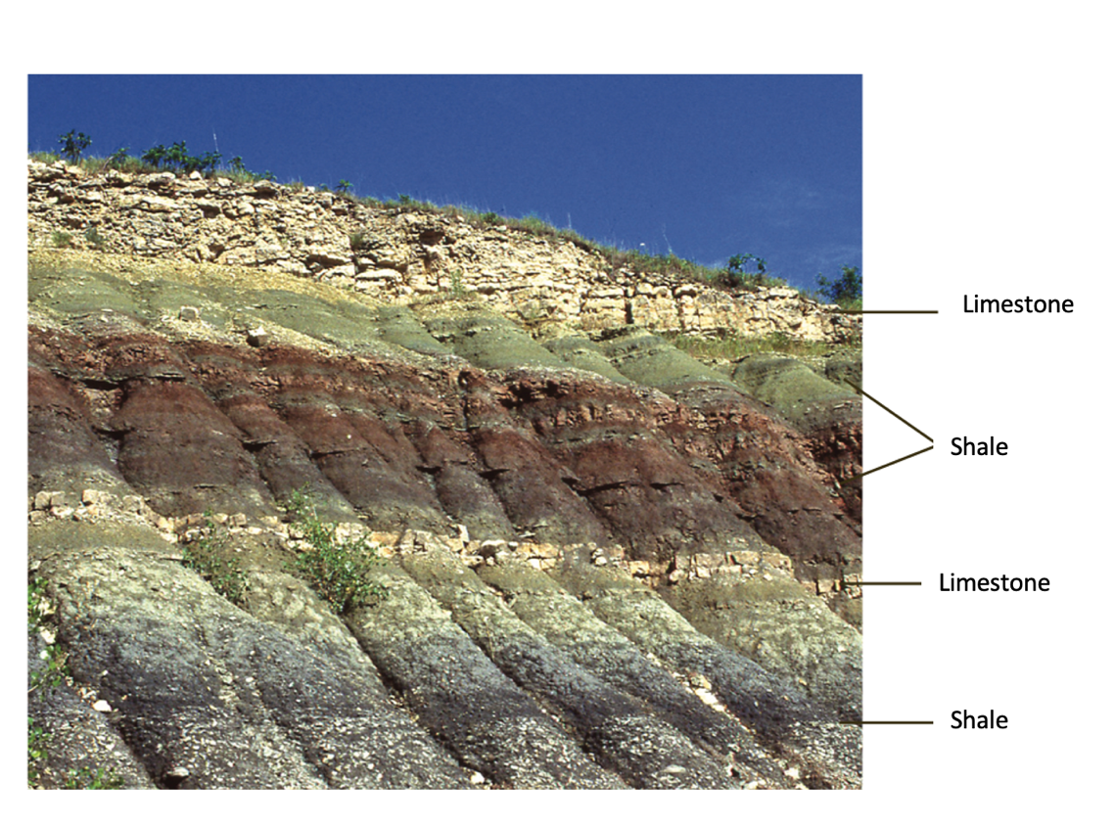
The Flint Hills are made of repeating layers of Limestone and Shale – like this:
10.

Slide 12
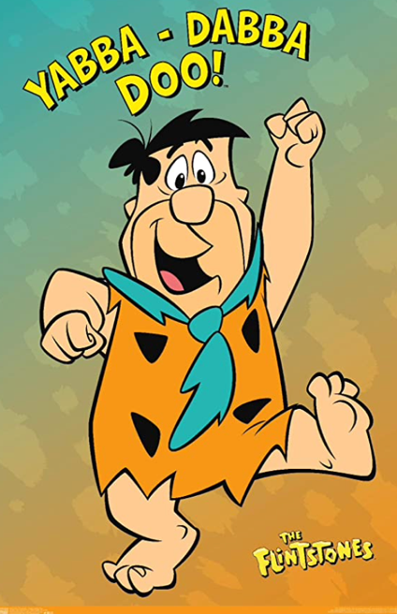
But…what about the Flint?
11.

Slide 13
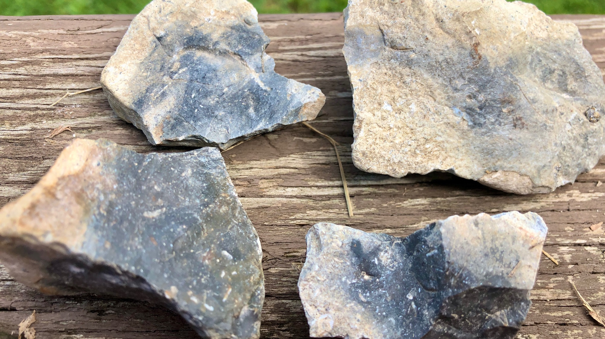
Flint
12.
Is gray, smooth rock
It can have VERY sharp edges
It looks and feels different from the rough Limestone
These 4 rocks have Flint in the middle – surrounded by white Limestone

Slide 14
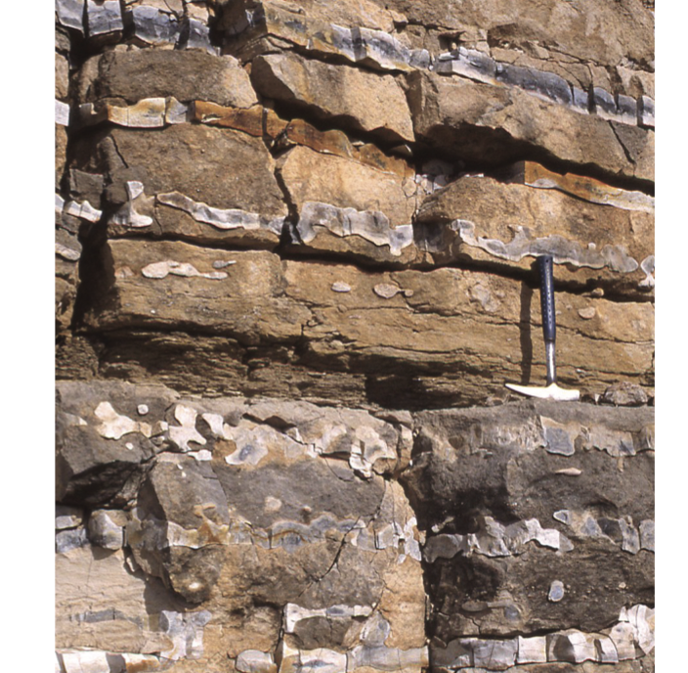
Where is the Flint?
13.
Flint is found in just some of the Limestone layers

Slide 15
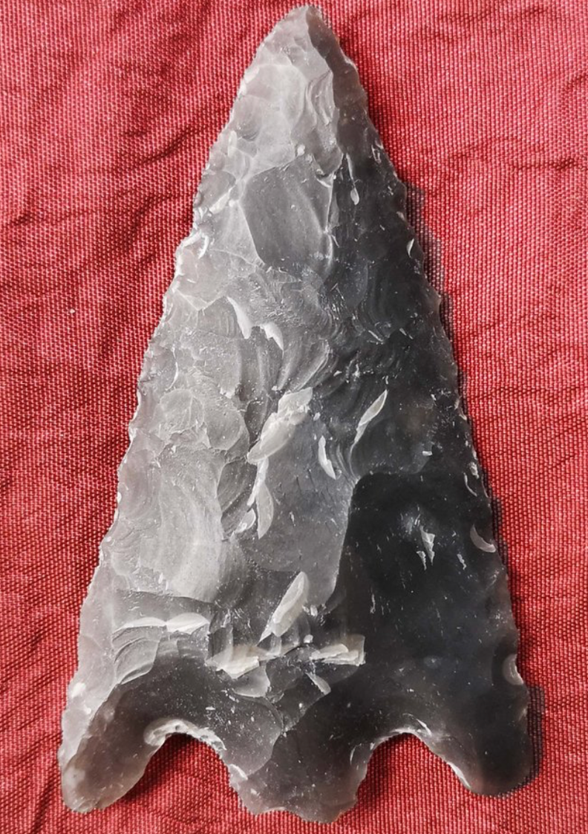
14.
What is Flint good for?
Flint was used by Native Americans to make hard, sharp arrowheads.

Slide 16
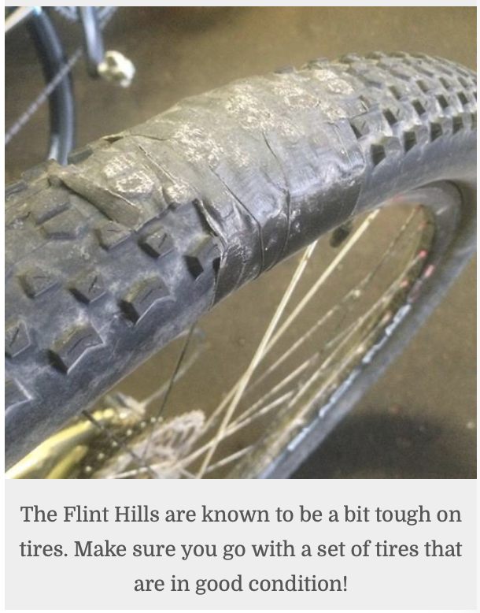
15.
What is flint good for?
Flint is hard and sharp!
Flint Hills residents who drive on gravel roads (that contain Flint pieces) learn this – they must replace their tires frequently.

Slide 17
16.
The next time you’re hiking in the Flint Hills, be on the lookout for:
Limestone
Shale
Flint
The rocks that saved the tallgrass prairie!

Slide 18
17.
How did rocks save the tallgrass prairie?

Slide 19
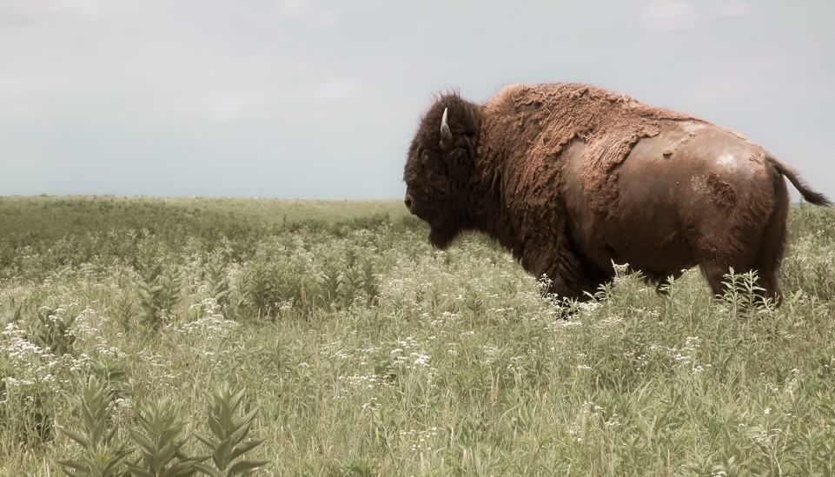
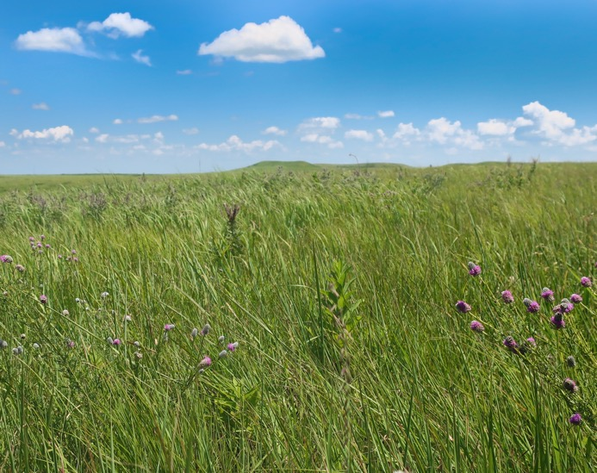
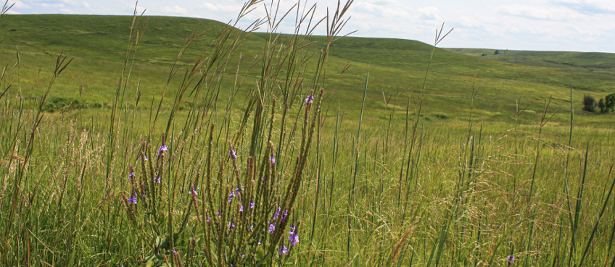
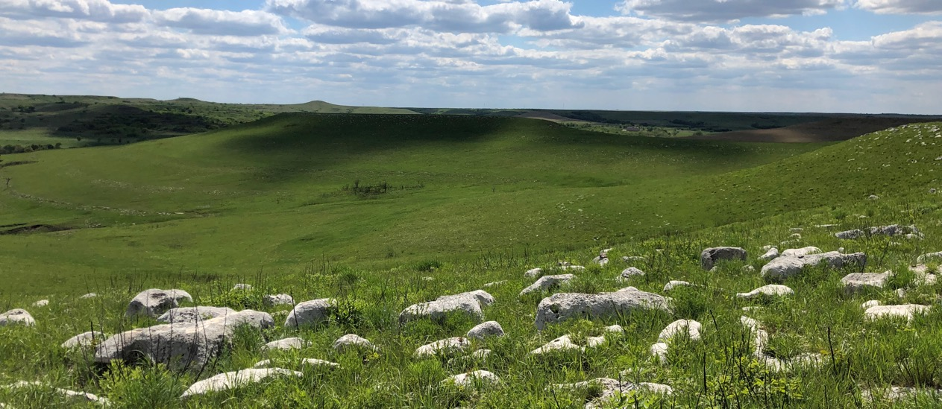
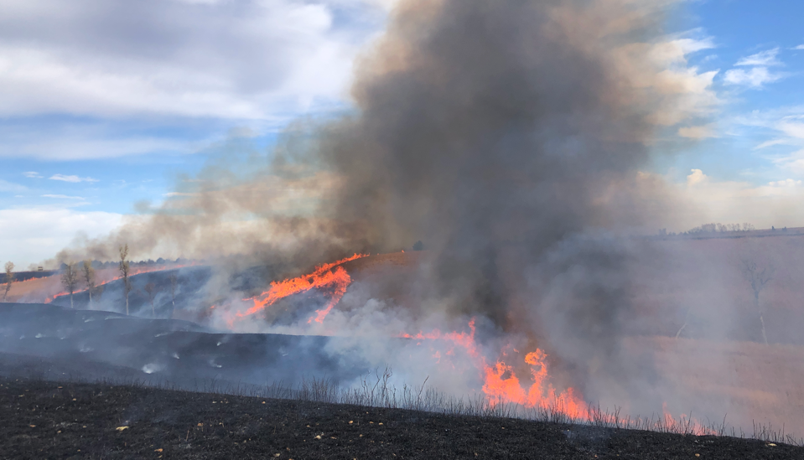
18.
What did you learn about the prairie this week?

Slide 20
Author:
Jill Haukos
Konza Environmental Education Program
Konza Prairie Biological Station
Manhattan, KS
© 2023

