Slide 1
Classification of Life
The Six Kingdoms
Prokaryota
Eukaryota
Bacteria
Protista
Plantae
Archaea
Fungi
Animalia
Notes:
Under this system we have 2 domains or realms and six kingdoms.
Eukaryotes have membrane-bound organelles. Fungi with chitin cell walls, plants autotrophic with cellulose, animals mobile with no cell walls, protists are the kitchen junk drawer

Slide 2
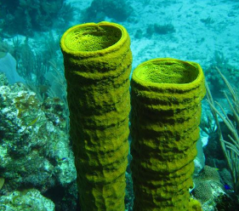
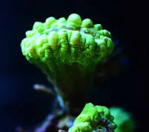
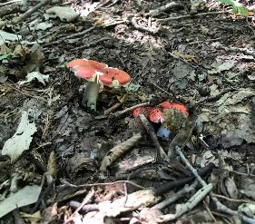
What are plants?

Slide 3
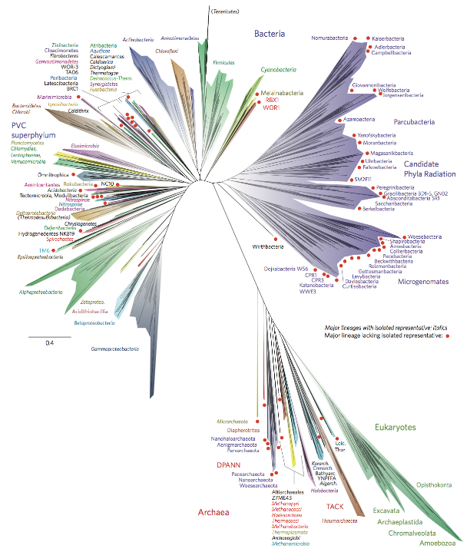
Classification of Life
Systematics
Taxonomy that describes evolutionary relationships (phylogeny)
Latin binomial is retained
Rank-based classification is too simple, breaks down
Hug, Laura A., et al. "A new view of the tree of life." Nature microbiology 1.5 (2016): 1-6.
Notes:
As you can see, this makes it much simpler!

Slide 4
Systematics
Placenta
Live birth
Cladogram
Fur, mammary glands
Amniotic eggs
Notes:
Shows evolutionary relationships and the arrival of certain traits.
Sometimes conflicts with Linnaean groups: 7 vertebrate classes (3 fish classes, Amphibians, reptiles, birds, mammals) All of the tetrapods here are fish.

Slide 5
Classification of Life
Linnaean Classification
Phylogenetic Classification
Simple, plainly organized
Organized but complex
Facilitate
communication
Based on evolutionary relationships
Based on
physical traits
Descriptive, but defies neat hierarchical ranking
Hierarchical system is intuitive but limited

Slide 6
What are plants?
Eukaryotic organisms that are:
(Mainly) multicellular
(Mostly) photosynthetic
(Traditionally) in the Kingdom Plantae
Notes:
Eukaryotes vs. prokaryotes
Endosymbiosis – primary and secondary
Several non-plant groups are multicellular, many others can photosynthesize (algae groups, other protists, fungi, and animals – corals, sponges, sea snails and sloths)

Slide 7
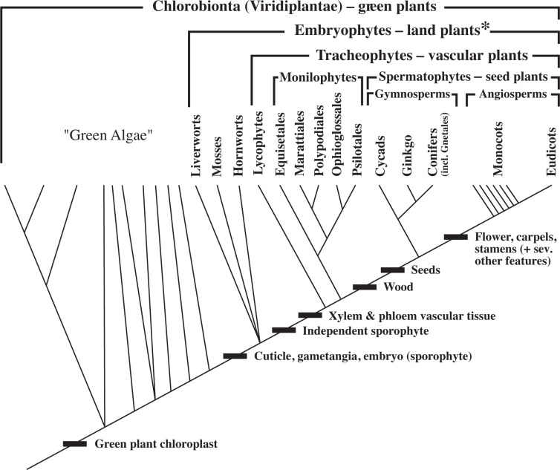
Simpson, Michael G. Plant systematics. Academic press, 2019.
Notes:
Back to exercise 1: where did our plants fit?

Slide 8
What are plants?
A lineage of eukaryotes that photosynthesize using green primary chloroplasts

Slide 9
Sundry terminology
Life span
Growth form
Nativity
Photosynthetic pathway

Slide 10
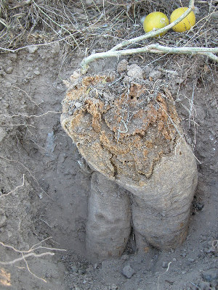
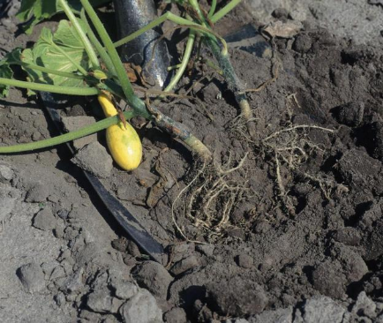
Sundry terminology
Life span
Annual
Biennial
Perennial
Growth form
Nativity
Photosynthetic pathway
Notes:
Annuals prioritize flowering and seed production, perennials need to store energy – often in roots
Some species may behave differently across their ranges

Slide 11
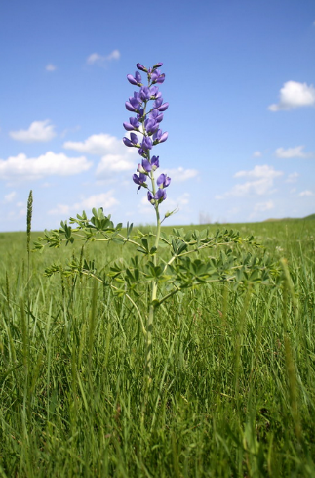
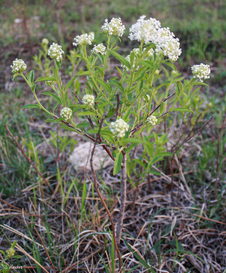
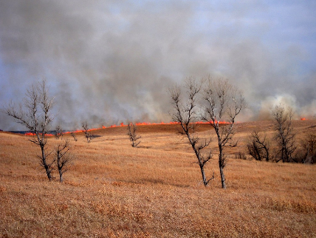
Sundry terminology
Life span
Growth form
Herbaceous/Woody
Monocot/Dicot
Graminoid/Forb
Nativity
Photosynthetic pathway
Notes:
Lignin and secondary growth

Slide 12
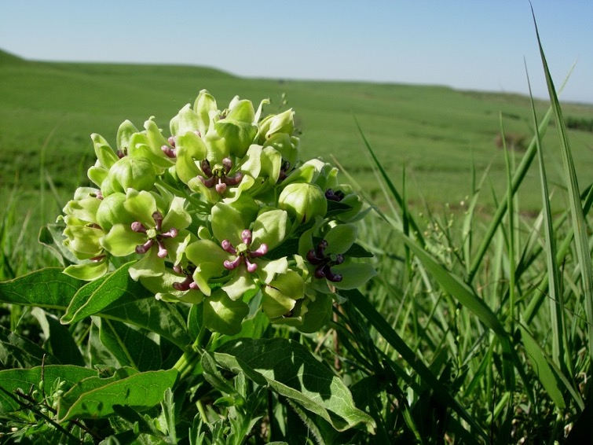
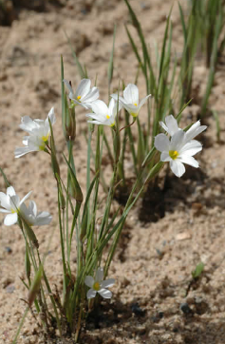
Sundry terminology
Life span
Growth form
Herbaceous/Woody
Monocot/Dicot
Graminoid/Forb
Nativity
Photosynthetic pathway
Notes:
Monocots have one cotyledon, parallel veins, vascular tissue in bundles, flower parts in multiples of 3
Dicots have 2 cotyledons, net venation, a ring of vascular tissue, flower parts in multiples of 4 or 5

Slide 13
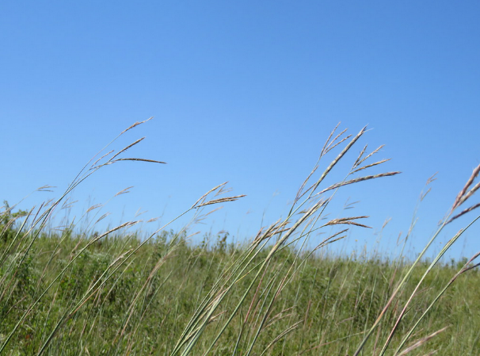
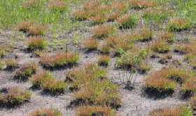
Sundry terminology
Life span
Growth form
Nativity
Native/Exotic/Invasive
Weed vs. Ruderal
Photosynthetic pathway

Slide 14
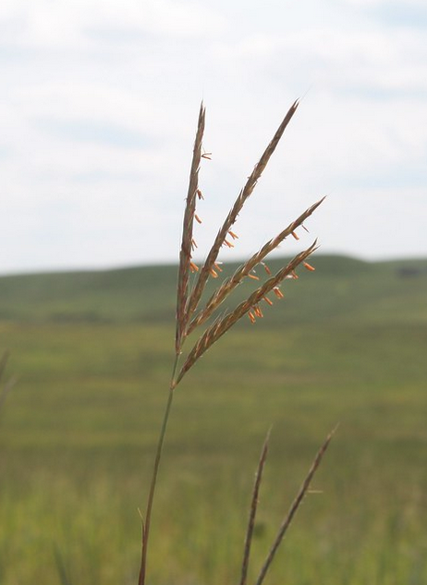
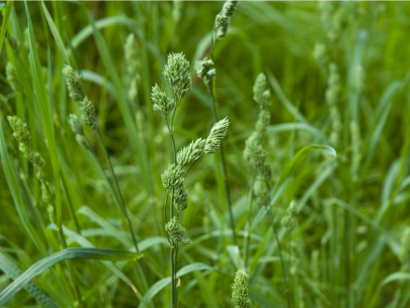
Sundry terminology
Life span
Growth form
Nativity
Photosynthetic pathway
C3/C4/CAM
Cool season/Warm season
Notes:
Pathway and phenology don’t always align – Tripsacum or Buchloe

Slide 15
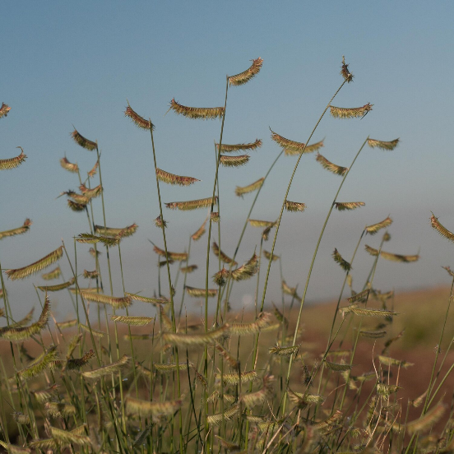
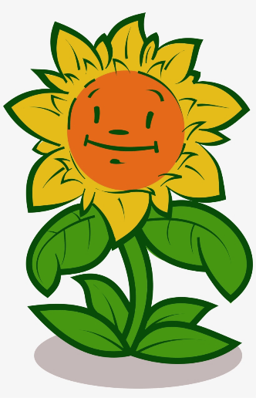
Factors Affecting Success
Environmental conditions
Temperature
Precipitation
Soil type
Resource limitation
Water
Light
Nutrients
Competition
Disturbance
Herbivory
Fire
Climate events
Life history
Find your HAPPY PLACE
Notes:
This is ecology – everything is related to everything else, we can’t discuss one of these things without discussing all of them
A Gordian Knot – we can cut the knot like Alexander, but we’ll me oversimplifying things if we do.
The combination of all these things constitutes a plant’s habitat, but a shift in one factor may change how a species responds to another: example Hairy grama.

Slide 16
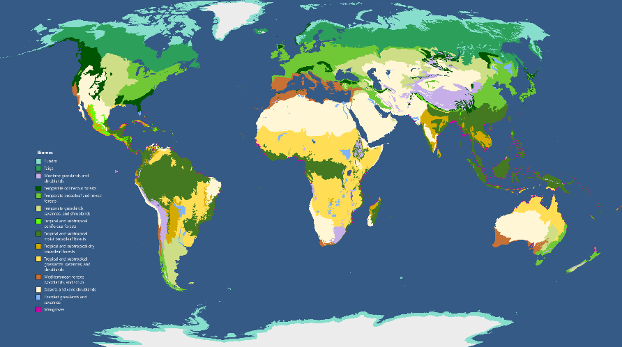
Biomes
Biotic communities with similar life forms and environmental conditions
Often defined in relation to dominant plant types
Terpsichores, CC BY-SA 3.0 <https://creativecommons.org/licenses/by-sa/3.0>, via Wikimedia Commons

Slide 17
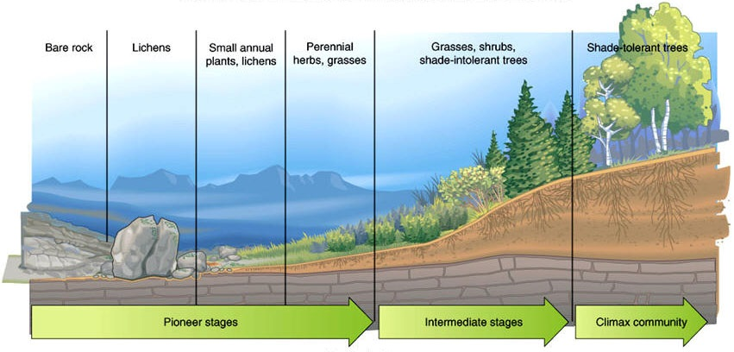
Ecological Succession
The young woodland remembers
the old, a dreamer dreaming
of an old holy book,
an old set of instructions,
and the soil under the grass
is dreaming of a young forest,
and under the pavement the soil
is dreaming of grass.
–Wendell Berry

Slide 18
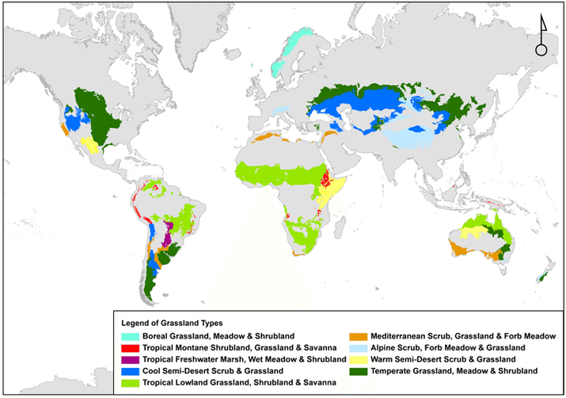
World Grasslands
Dominated by herbaceous plants
-mostly grasses
Can be tropical or temperate
-usually seasonal
Woody growth is limited
-climatic or edaphic
-disturbance
Zhou, Quanlai, et al. "Soil phosphorus budget in global grasslands and implications for management." Journal of Arid Environments 144 (2017): 224-235.

Slide 19
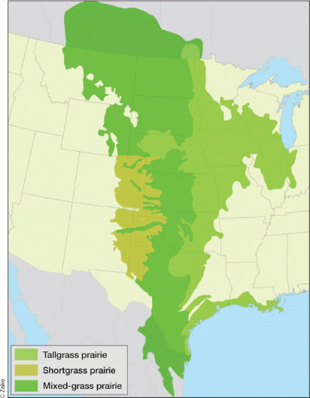
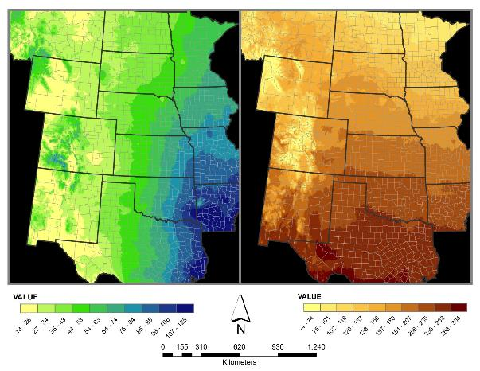
Great Plains of North America
From DeLuca and Zabinski 2011

Slide 20
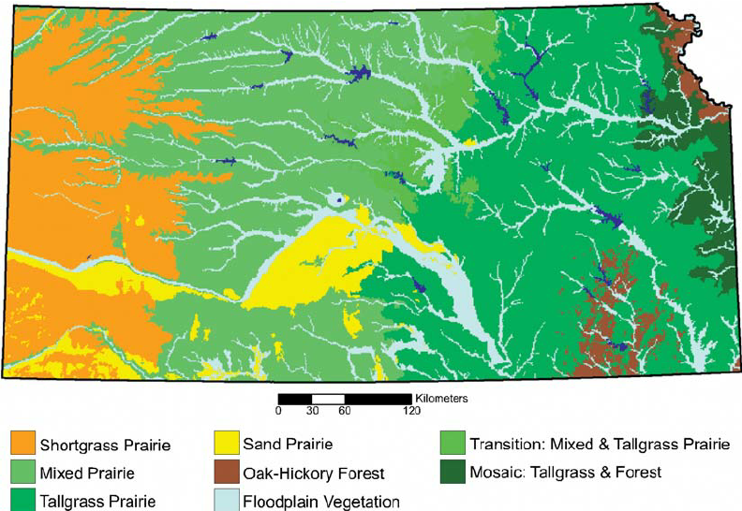
Kansas Ecoregions
Kuchler 1974

Slide 21
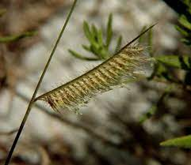
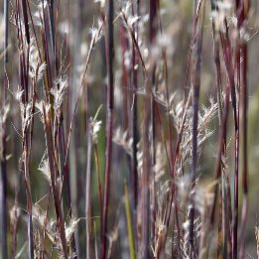
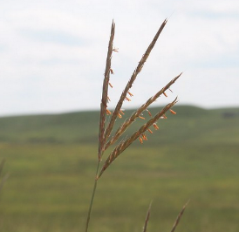
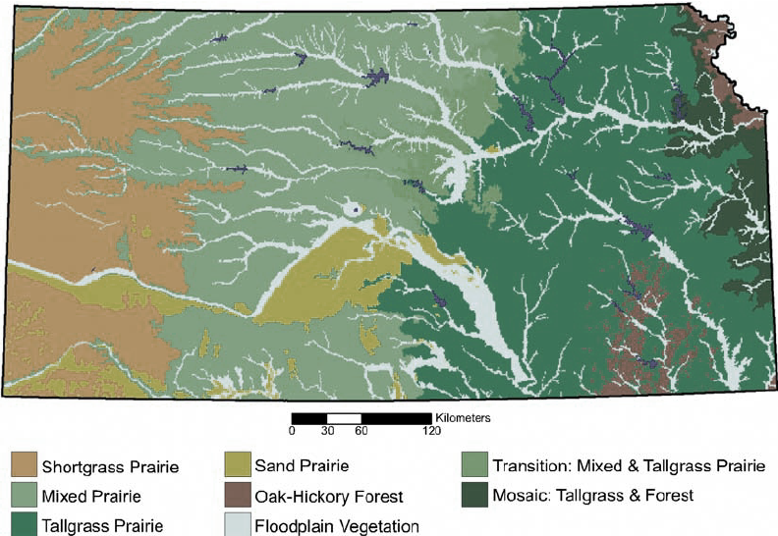
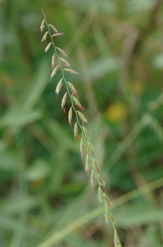
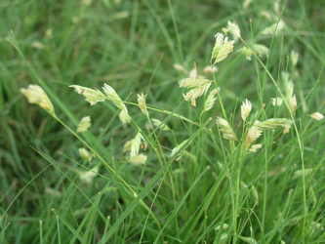
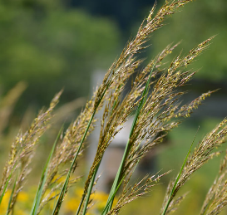
Kansas Ecoregions
Kuchler 1974

Slide 22
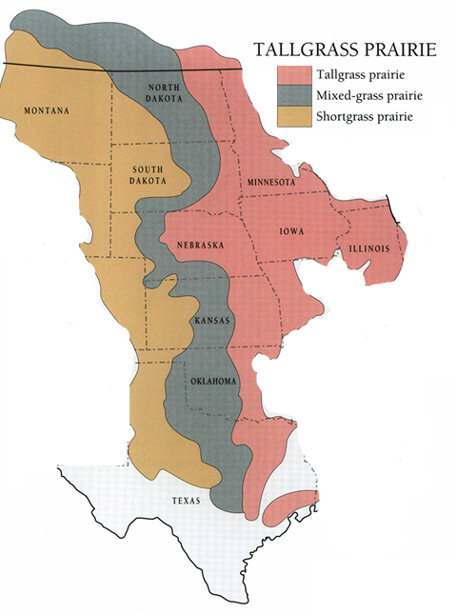
dry
wet
Flint Hills Ecoregion
*
*
Konza Prairie
Biological Station
KPBS sits at the dry western edge of the original tallgrass range and on shallow soils; highly responsive to precipitation variability

Slide 23
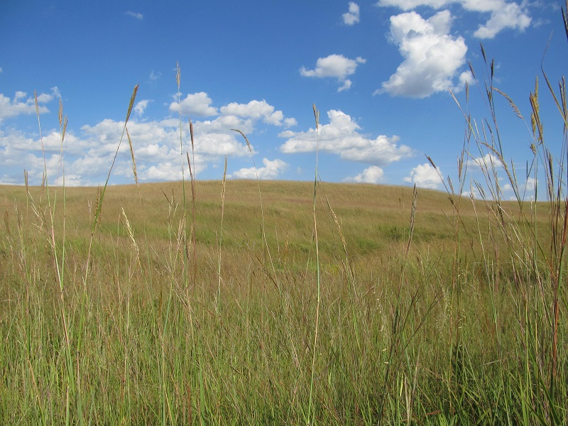
Konza Prairie Biological Station
8.5k acre tallgrass prairie preserve dedicated as an ecological research laboratory
Bluestem range – dominated by warm-season grasses mixed with various forb species
Complicated by a complex topography, variable climate, disturbance by fire and large herbivores

Slide 24
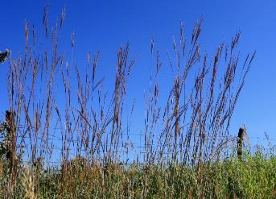
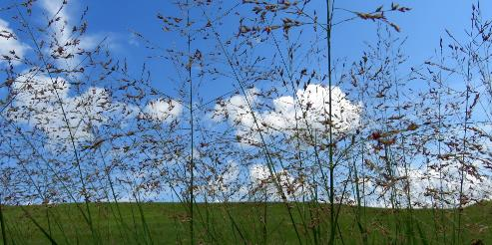
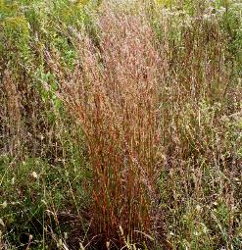
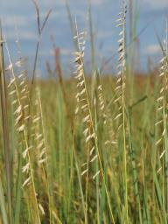
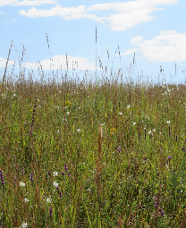
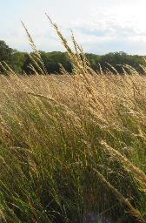
Konza Prairie plant communities
Dominated by warm-season C₄ grasses
Notes:
84 total grass species; 63 native grasses (75% perennial), 21 introduced species;

Slide 25
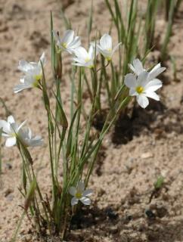
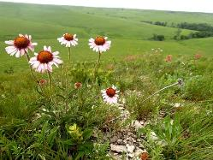
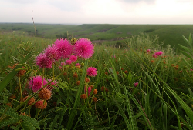
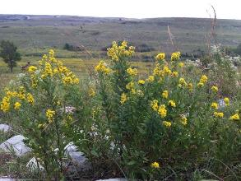
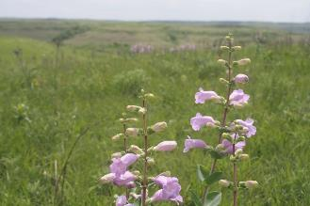
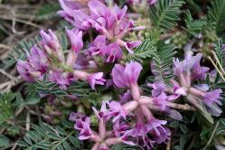
Konza Prairie plant communities
Forb species comprise the bulk of plant biodiversity
Eva Horne
Eva Horne
Eva Horne
Notes:
In total, 597 species of vascular plants recorded on Konza…. Forbs are the most numerous and diverse group of Konza plants, accounting for almost 70% of all vascular species

