Slide 1
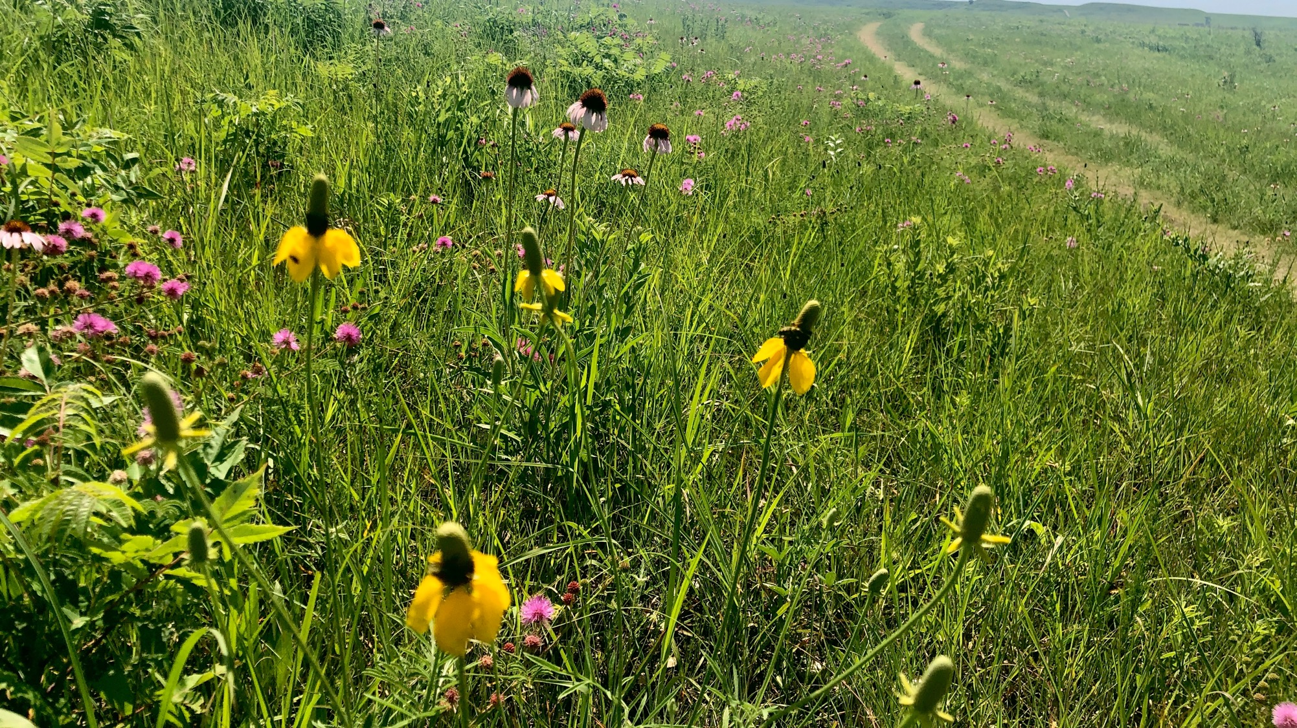
The Prairie
A storyline

Slide 2
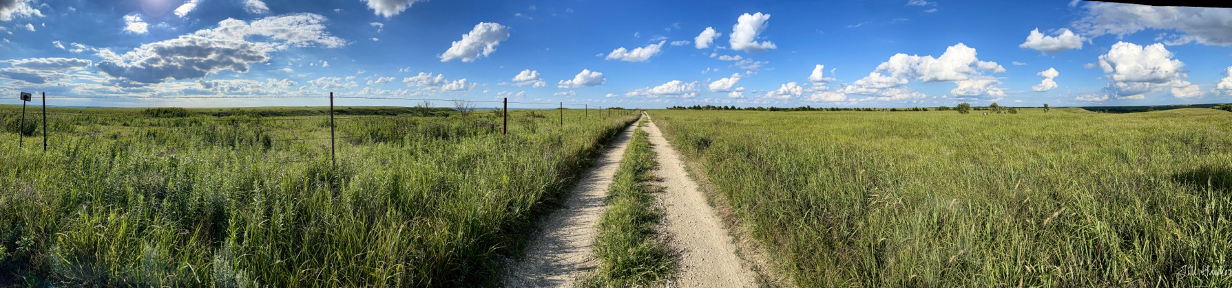
1. Observe and Question
If we were to visit the Konza Prairie Biological Station outside of Manhattan, Kansas, we would go down this very road.
There’s prairie on both sides of the road – do the two sides look the same?
What do you notice?

Slide 3
In your notebook, divide your paper into 3 columns – with the following titles:
I notice…
I wonder…
Could it be…

Slide 4
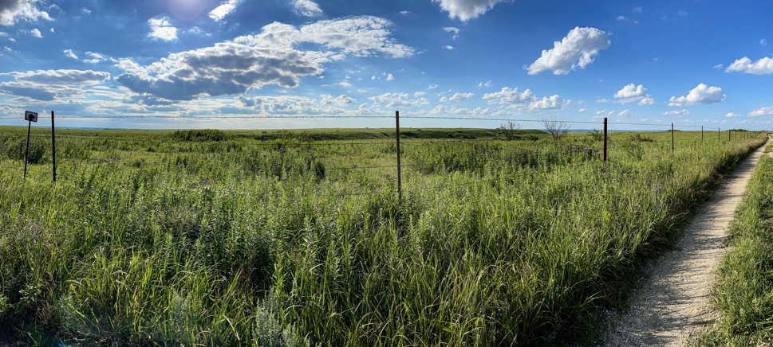
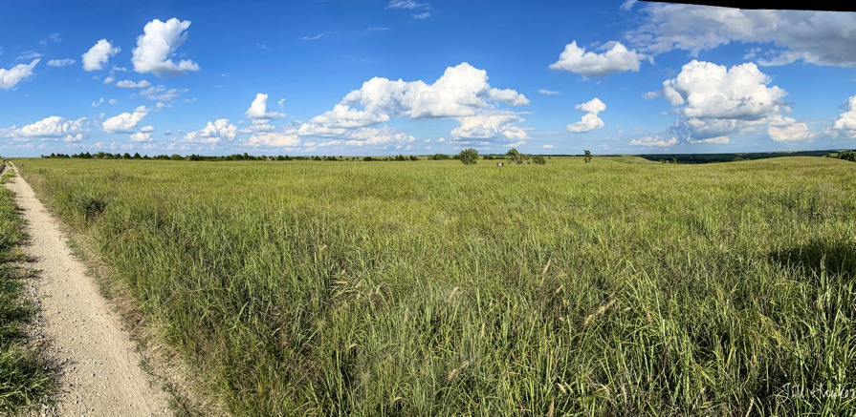
Let’s take a closer look…
Notes:
Here, we can clearly discern that there is a difference between the two sides of the road. There is also a fence present, that provides a pretty significant clue. There is no fence on the right side. The kinds of plants present on the left look quite a bit different from the plants on the right. Let’s look more closely at what these plants appear to be.

Slide 5
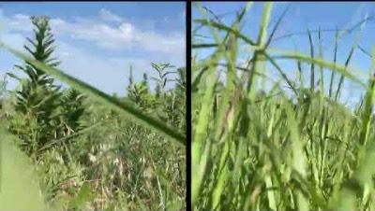
Let’s take a closer look – what kind of animal would have this view, do you think?
Notes:
Ground level – this is what a coyote sees as it walks through the prairie. Note how the composition of plants is vastly different between the two sides of the road. What side of the road has more bugs?

Slide 6
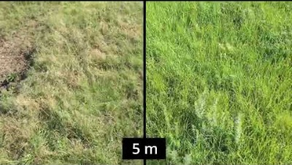
Here’s another view – a little bit higher and further from the ground. Who’s view might this be?
Notes:
This view is from 5 m high – what a bison sees as it walks through the prairie.

Slide 7
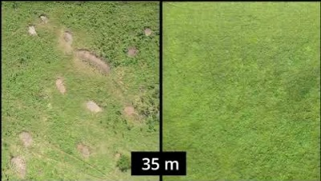
And a final view – from the sky. Who might have this view?
Notes:
This view is from 35 m high – what a hawk sees flying over the prairie.

Slide 8
What is different between the two sides of the road?
Why are there differences between the two sides?
Which side is better?
Notes:
Here, we can clearly discern that there is a difference between the two sides of the road. There is also a fence present, that provides a pretty significant clue. There is no fence on the right side. The kinds of plants present on the left look quite a bit different from the plants on the right. Let’s look more closely at what these plants appear to be.

Slide 9
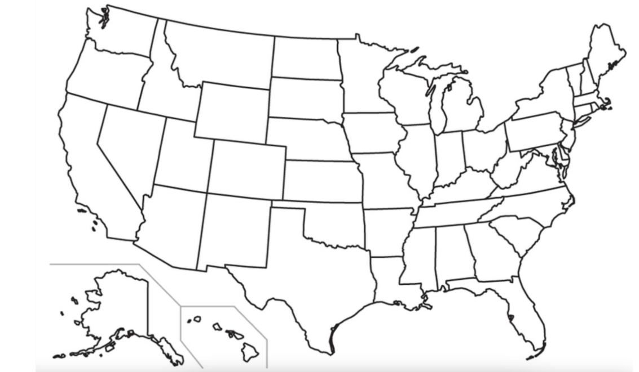
Working with a partner, look at the map of the United States.
Using different colors:
Put a dot where you think you live.

Slide 10
Working with a partner, look at the map of the United States.
Using different colors:
Put a dot where you think you live.
Choose a different color and draw the outline of where you think “prairie/grasslands” used to be. Think 150 yrs. ago...

Slide 11
Working with a partner, look at the map of the United States.
Using different colors:
Put a dot where you think you live.
Choose a different color and draw the outline of where you think “prairie/grasslands” used to be. Think 150 yrs. ago...
With a different color, draw where you think the "prairie/grasslands" exist today.

Slide 12
Now that you know this is the historic range of prairies in the U.S. – add your thoughts to your Notice/Wonder/Could it be chart.
Does this map match up with what you and your partner drew?

Slide 13
In your notebook, divide your paper into 3 columns – with the following titles:
I notice…
I wonder…
Could it be…

Slide 14
Now that you know this is the current range of prairies in the U.S. – add your thoughts to your Notice/Wonder/Could it be chart.
Does this map surprise you?

Slide 15
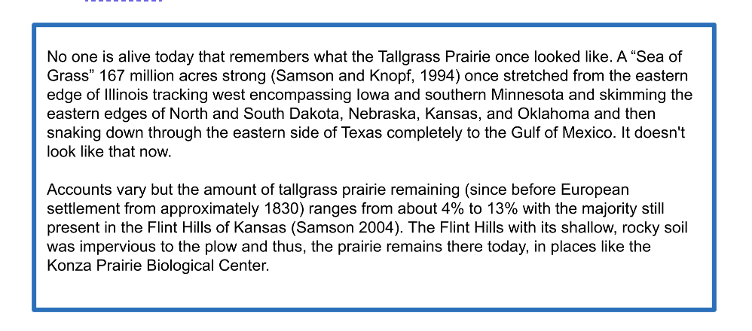

Slide 16

Class discussion
Did the maps you drew match the actual outline of the maps - both historical and current?
Much of the original prairie is now gone,
where did it go?
What good is a prairie?
What makes a good prairie?

Slide 17
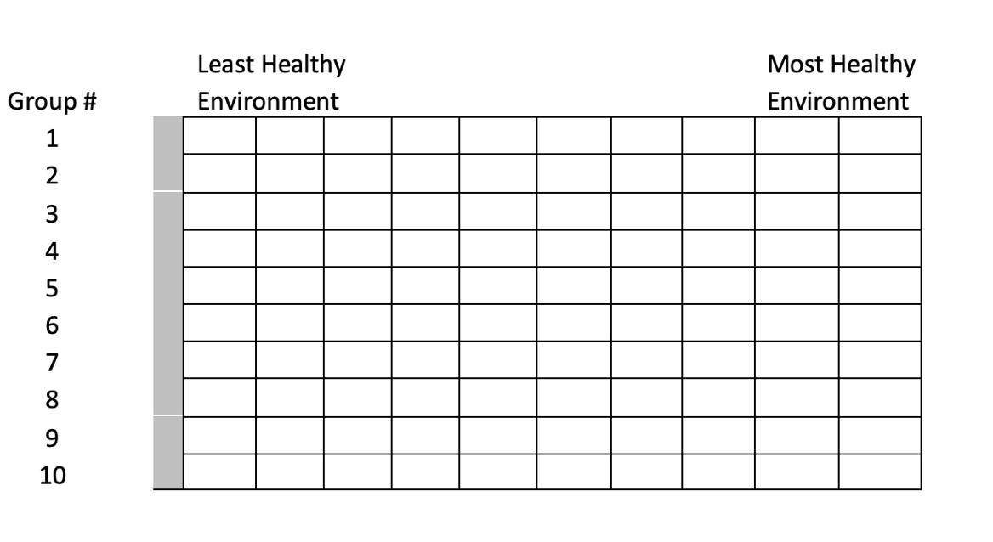
Compare and contrast different environments in your daily lives.
Put your Environment Cards in order – from Least Healthy to Most Healthy
Recreate this chart on the white board

Slide 18
Returning to your notes – put a star by questions that need to be answered
I notice…
I wonder…
Could it be…

Slide 19
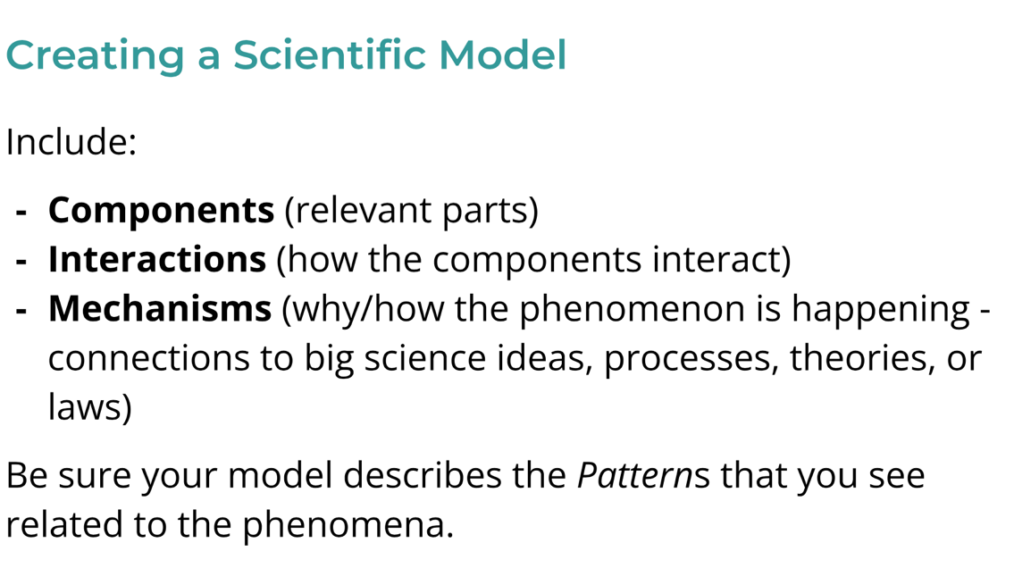
MODEL
Draw an initial model of your environment in your notebook
Include what we know SO FAR about our environment

Slide 20
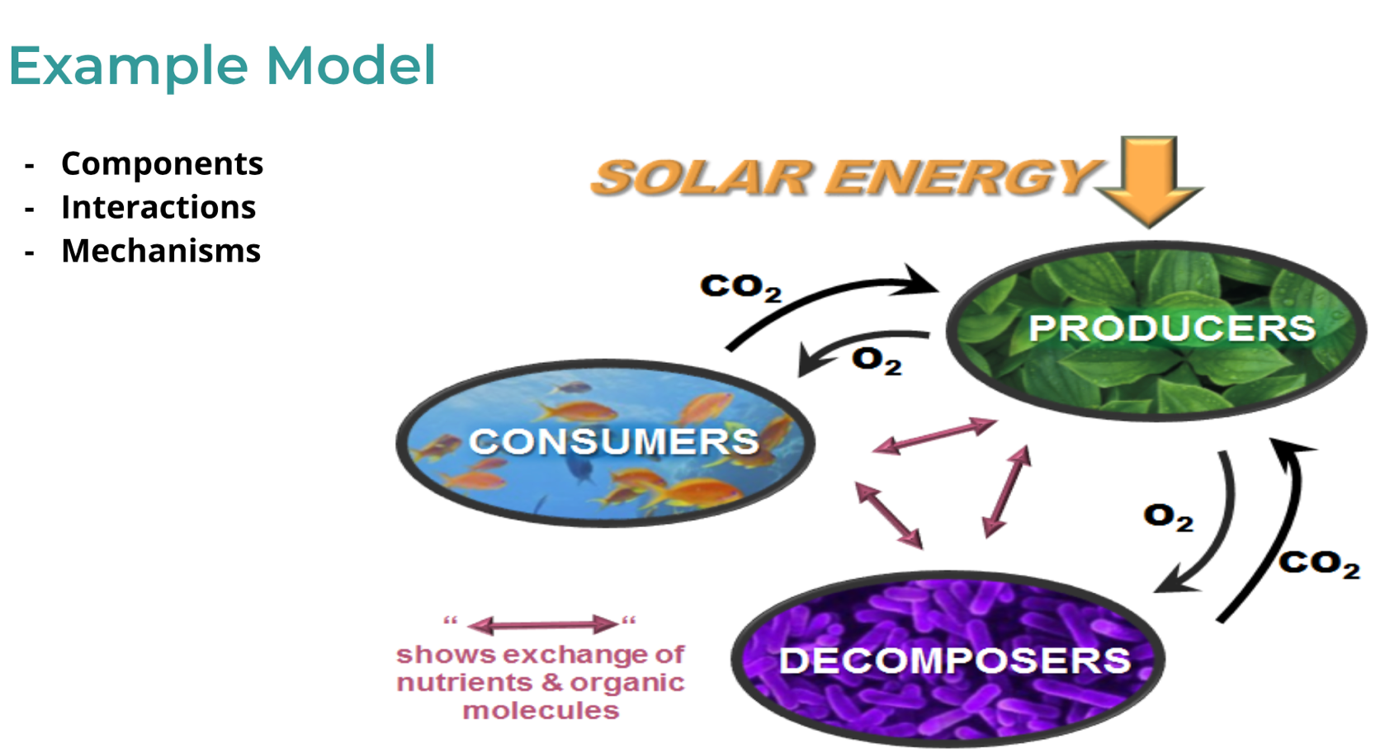

Slide 21
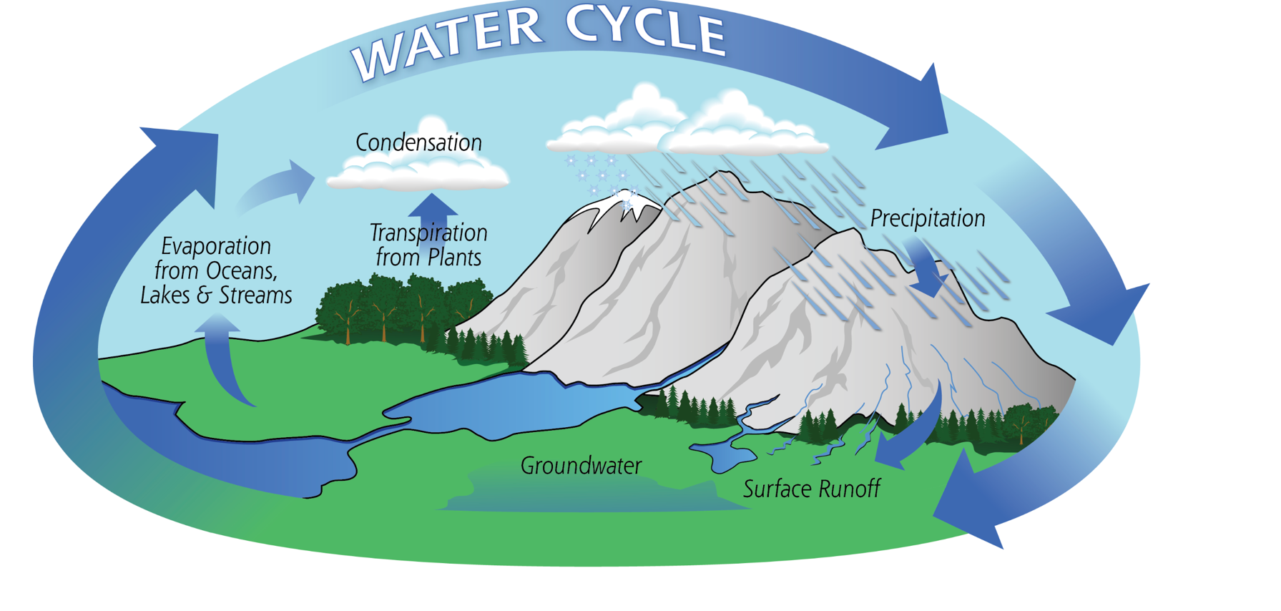

Slide 22
Throughout our investigation of the ecology of the tallgrass prairie, we will be using the Incremental Modeling Tracker (IMT) as a thinking tool to help us keep track of and figure out important discoveries. You will refer back to the IMT regularly to help prioritize ideas and revise or build on our models. We will also use the IMT as a way to think with others about what is important in our models.
DRIVING QUESTION: What good is a prairie? What is a good prairie?
LESSON QUESTION (What Question Are We Trying to Answer?) & LESSON NICKNAME | WHAT DID WE FIGURE OUT? Which parts of what we figured out (if any) can help us with our model? (Highlight them!) | BASED ON OUR PROGRESS THIS LESSON, HOW CAN WE ADD TO OR REVISE OUR MODEL? How should we represent our ideas in our model? (Use pictures, words, or symbols)
1
INCREMENTAL MODELING TRACKER (IMT)

Slide 23






Authors:
Jill Haukos – Konza Environmental Education Program - Konza Prairie Biological Station
Noah Busch - Manhattan-Ogden Public Schools
Robert Hamilton – Linn Mar Community School District, Marion, IA
Jennifer Karr – Manhattan – Ogden Public Schools
Brad Fabrizius – Manhattan-Ogden Public Schools
Benji George – Manhattan-Ogden Public Schools
Brittny England – Riley Counrty School District
Contributors:
Dr. Brian McCornack - Kansas State University
Dr. Zak Ratajczak – Kansas State University
Bess Bookout – Kansas State University
Mary Linabury – Colorado State University

