Slide 1
Bison on the Prairie

Slide 2
1.
Bison!
They’re fun and important parts of the prairie.

Slide 3
Let’s watch a video of the bison on the prairie!
2.
Notes:
VIDEO clip – of bison – time: 1 min. 48 seconds
While viewing the video – have the students answer these questions
(either verbally or on their worksheet)
QUESTION: Did you see the bison swinging their tails? Why do you think they were doing that?
Answer: Bison swing their tails to try and discourage the flies from landing on them and biting them. BUGS!
QUESTION: What were most of the bison doing during the video?
Answer: They were relaxing – some were rolling, some were sleeping, some were eating.
QUESTION: Did you see some baby bison calves? What were they doing?
Answer: The calves were standing or lying next to their mothers. Some were nursing. Some of the youngest calves were still bright orange – the color of their coats when they are born. The older calves were beginning to lose their orange coats and turn more brown, like the rest of the herd.
QUESTION: Did you see any bison rolling in the grass? That’s called “wallowing”. Why do you think they do that?
Answer: Bison roll in the dirt to scratch itches and to coat their hair with mud. The mud helps to keep the bugs from biting them. BUGS!

Slide 4
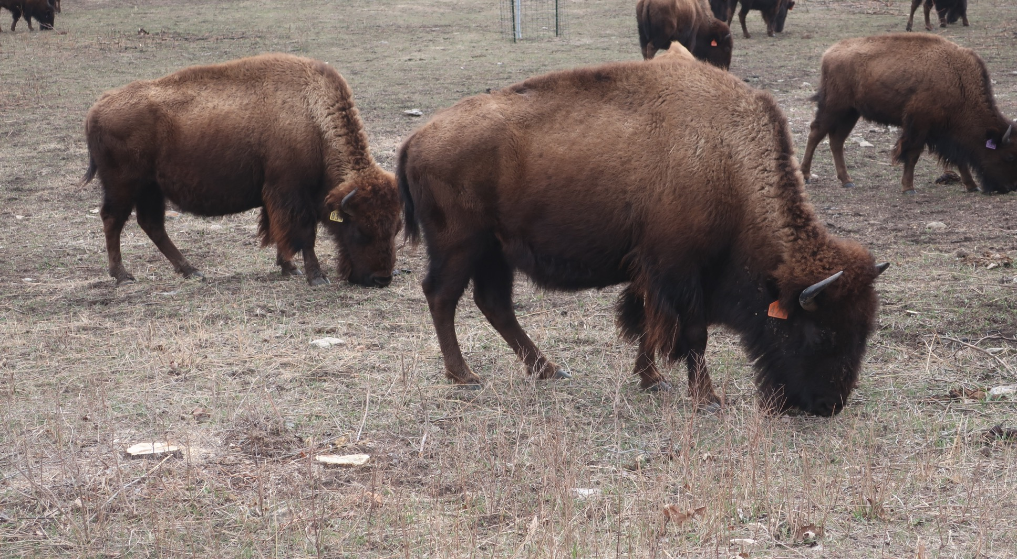
Bison spend a lot of time doing this:
3.
What do bison eat?
Notes:
Answer = Grazing!
TEACHER HELP: They’re grazing on old dead grass from the year before – this photo was taken in March – before the spring burning.
QUESTION: What do bison eat?
Answer = grass

Slide 5
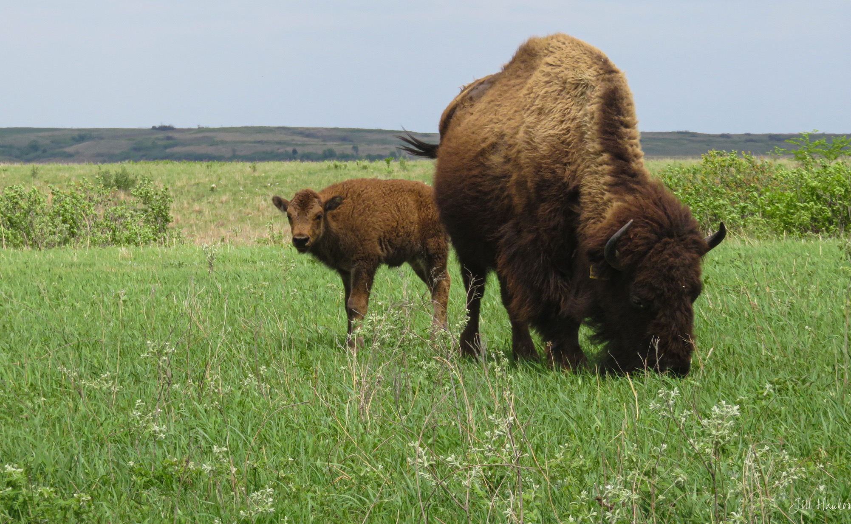
4.
Bison eat grass. They don’t eat wildflowers.
Do you think bison hurt the grass when they walk over it and eat it?
Notes:
QUESTION: do you think the bison hurt the grass when they walk over it and eat it?
Answer: The bison do NOT kill the grass by walking on it or by eating it. The grass is used to being walked on and will grow brand new leaves after other leaves are eaten. Those new leaves are especially soft and very tasty to bison!

Slide 6
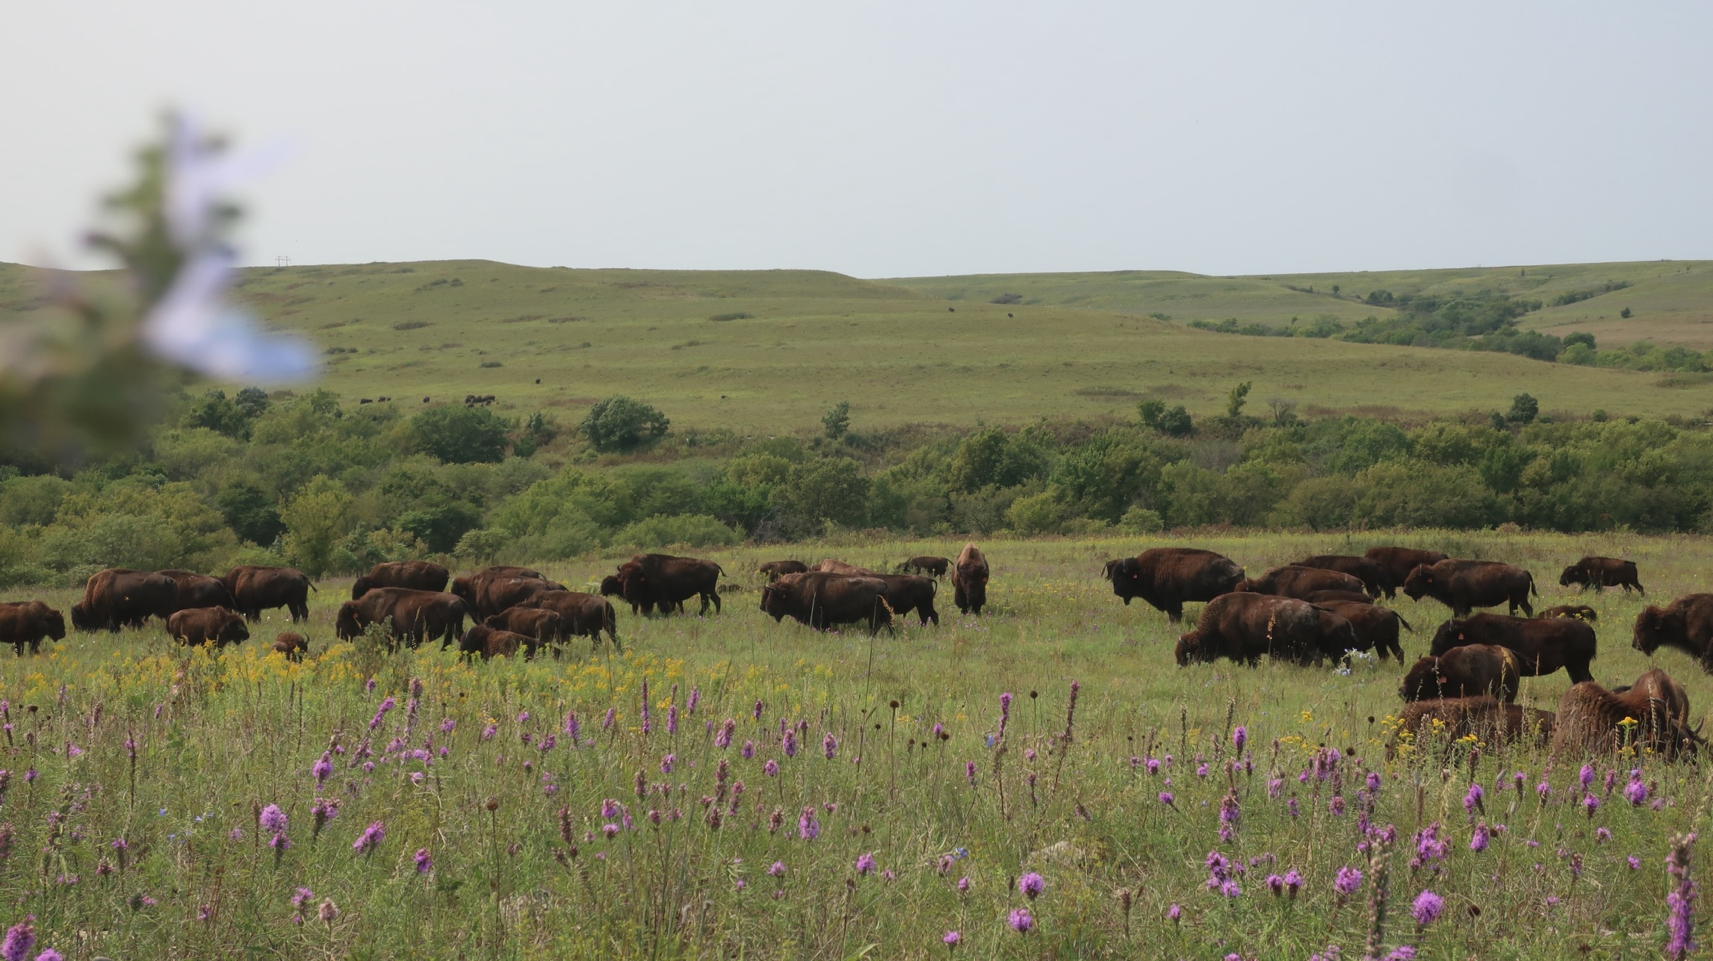
5.
When the bison eat the grass, they cut it short.
This gives the wildflowers a chance to grow!
Notes:
TEACHER HELP: The tallgrasses are the dominant plant of the prairie. When bison eat the tallgrasses (before they get a chance to get too tall) they eliminate the wildflower’s competition. The wildflowers get a chance to grow and are, therefore, very numerous in the bison area!

Slide 7
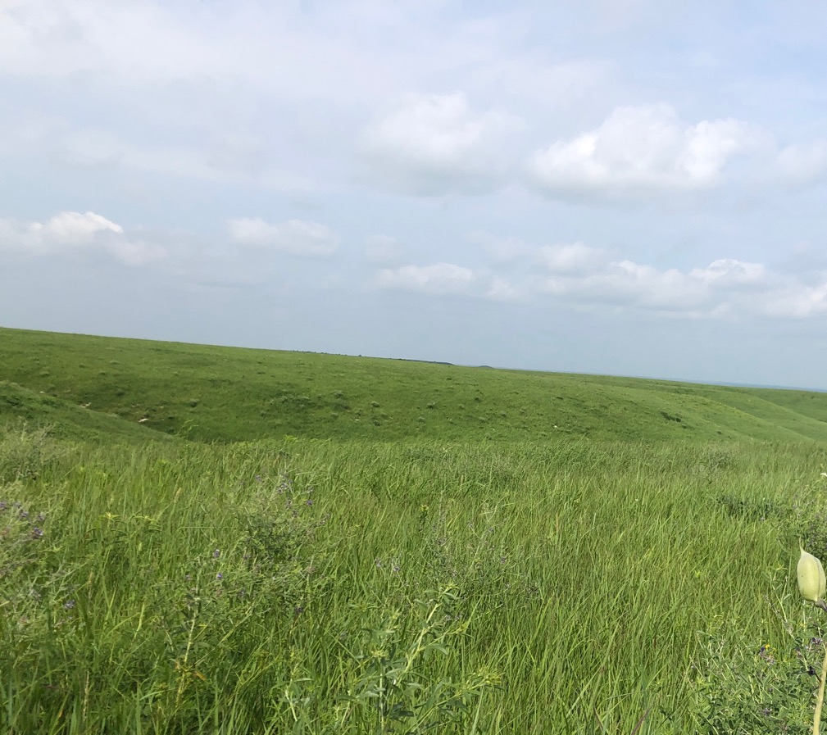
There’s a LOT more wildflowers where bison graze than where they’re not allowed to graze.
6.
Grazed by bison
Not grazed by bison
Notes:
VIDEO clip – of bison feeding – time: 2 min. 13 seconds
VIDEO NOTES: The person recording the bison grazing was safely standing behind a barbed wire fence at all times. This person was also being VERY careful to be quiet and respectful of the bison herd. Because they were quiet the bison acted like that person was not there.

Slide 8
7.
If you were a bee or a butterfly – where would you go?
A. To the bison-grazed prairie
B. To an ungrazed prairie
Notes:
Answer: There are a LOT more wildflowers in the area where the bison graze. Because the grazed area has more flowers, it will also have more bees and butterflies – insects who are looking for nectar and pollen from the wildflowers.

Slide 9
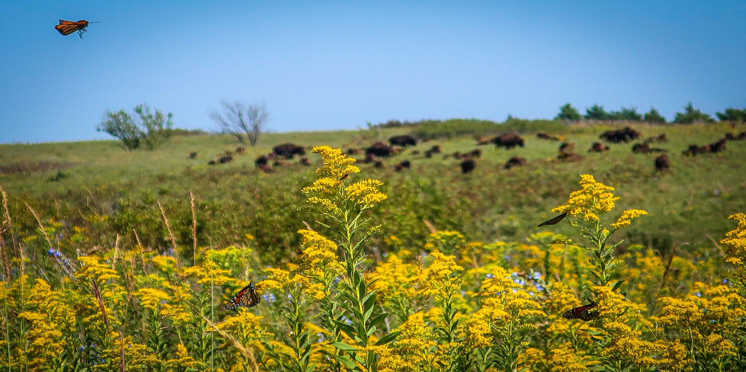
8.
The bison area of the prairie gets LOTS more bees and butterflies.

Slide 10
Watch a video of the migrating Monarch butterflies in the bison area of Konza Prairie
9.
Notes:
TEACHER HELP: Monarch butterflies migrate (fly) south for the winter like some birds do. These Monarchs are stopping over at Konza to drink nectar from the wildflowers and to rest (roost) at night in the trees to gain strength for their long journey south to spend the winter in Mexico.

Slide 11
10.
Do you think the bison help or hurt the prairie?
How do bison help or hurt the prairie?
Notes:
Answer: The bison help the prairie very much. They eat the grass, which allows the wildflowers a chance to grow. With the wildflowers come the pollinators – butterflies and bees. There are many more different kinds of plants and animals in the bison area than outside of it. The bison also create wallows which can fill with water and become mini marshes. I’m sure the kids will come with many other ideas, most of them will be correct.

Slide 12
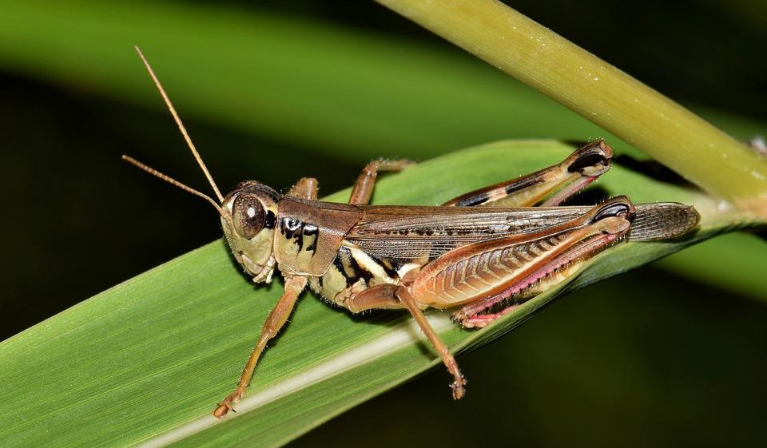
11.
Did you know… there is one animal on the prairie that eats more grass than the bison?
Who do you think that might be?
Notes:
TEACHER HELP: Collectively, all of the grasshoppers on Konza Prairie eat more grass than the entire bison herd. If we put all of the weight of the grass eaten by grasshoppers on one side of a scale and all of the grass eaten by bison on the other side of the scale – guess which pile of grass would be bigger? The grasshopper’s pile of grass. They are a very important animal!
Yes, grasshoppers are animals. They are part of the animal kingdom, just like all insects are.

Slide 13
Next, we look at the grasses of the prairie!
12.

Slide 14
Author:
Jill Haukos
Konza Environmental Education Program
Konza Prairie Biological Station
Manhattan, KS
© 2023

